Slide 1
Sample Blending
How Well Does It Work?
Sierra Davis Thomander and Jon Krosnick
Stanford University

Slide 2
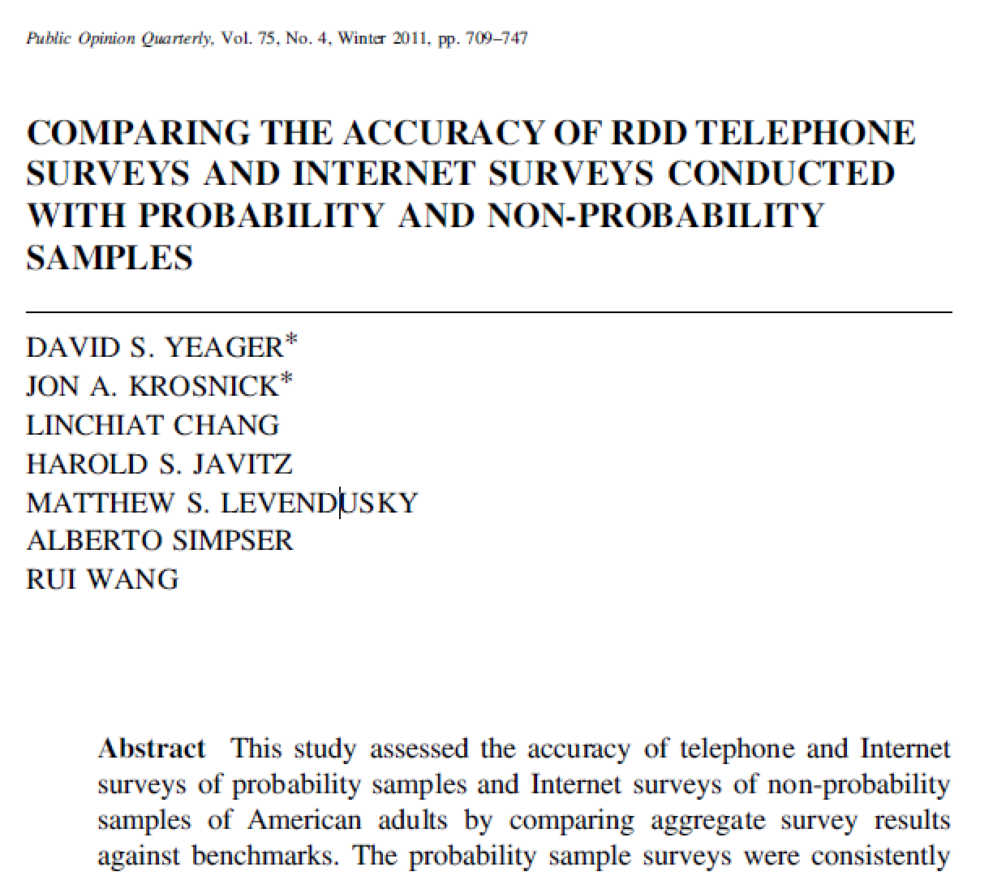
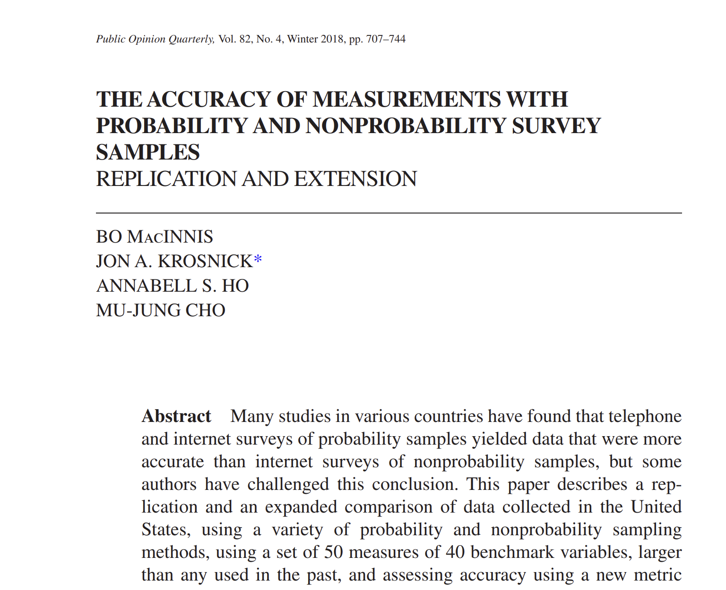
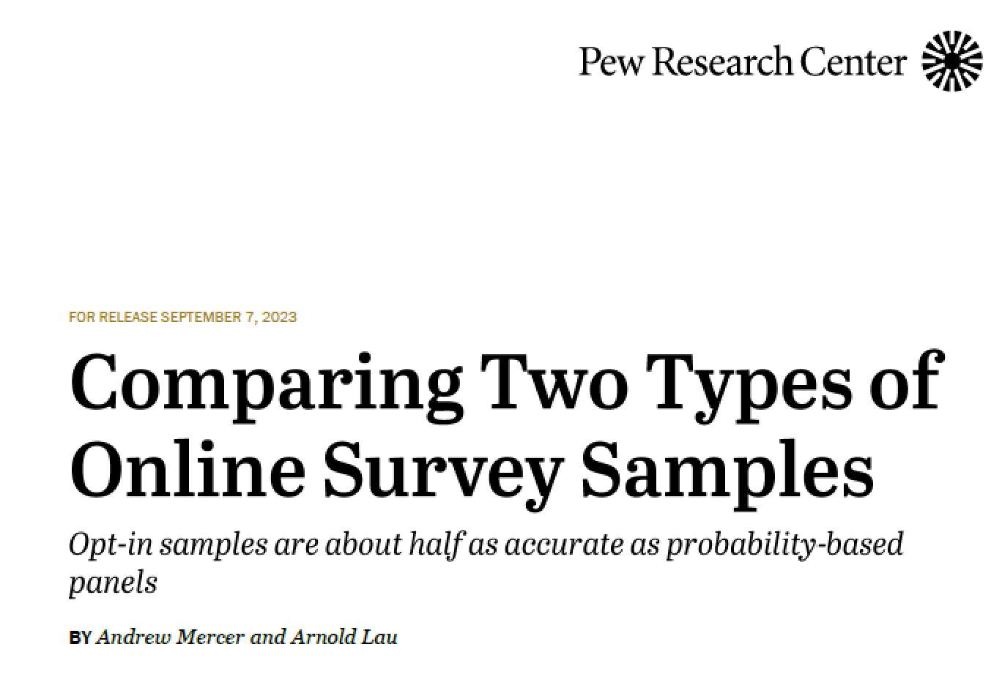
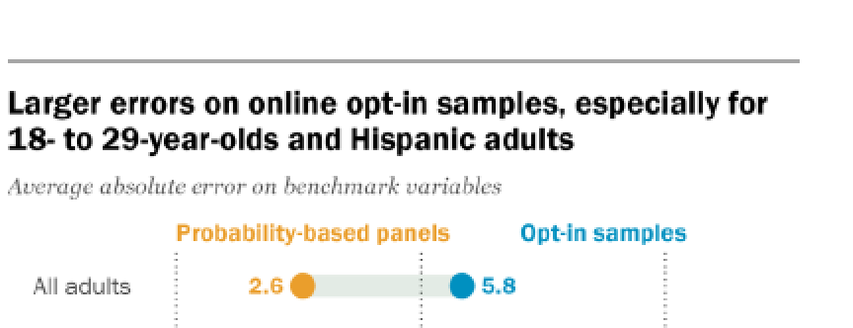
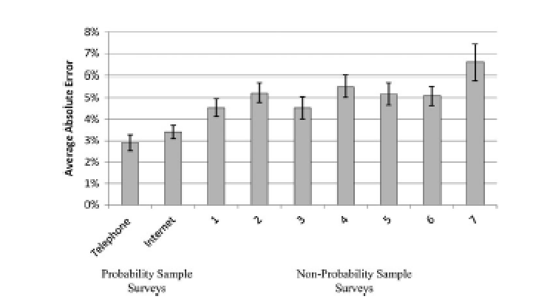
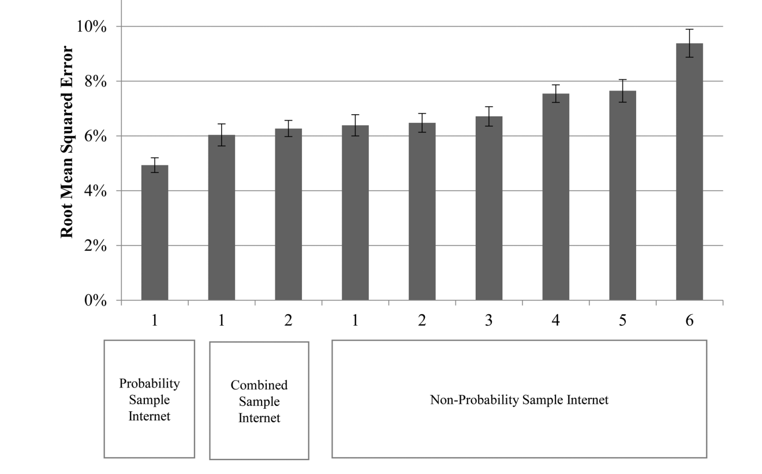

Slide 3
Our Agenda
Probability samples
  Highly accurate estimates
Non-probability samples
  Consistently less accurate
  Sometimes (and unpredictably) strikingly inaccurate
Blended samples?
  Probability sample plus a non-probability sample
  Weight the latter to the former using topic-specific variables
Notes:
Sources:
Bo MacInnis, Jon A Krosnick, Annabell S Ho, Mu-Jung Cho, The Accuracy of Measurements with Probability and Nonprobability Survey Samples: Replication and Extension, Public Opinion Quarterly, Volume 82, Issue 4, Winter 2018, Pages 707–744, https://doi.org/10.1093/poq/nfy038
Baker, Reg, Stephen J. Blumberg, J. Michael Brick, Mick P. Couper, Melanie Courtright, J. Michael, Don Dillman, Martin R. Frankel, Philip Garland, Robert M. Groves, Courtney Kennedy, Jon Krosnick, Paul J. Lavrakas, Sunghee Lee, Michael Link, Linda Piekarski, Kumar Rao, Randall K. Thomas, and Dan Zahs. 2010. “AAPOR Report on Online Panels.” Public Opinion Quarterly 74:711–81.
Baker, Reg, J. Michael Brick, Nancy A. Bates, Mike Battaglia, Mick P. Couper, Jill A. Dever, Krista J. Gile, and Roger Tourangeau. 2013. “Report of the AAPOR Task Force on Nonprobability Sampling.” Accessed January 2014. Available at https://www.aapor.org/AAPOR_Main/media/ MainSiteFiles/NPS_TF_Report_Final_7_revised_FNL_6_22_13.pdf.

Slide 4

Probability Sample
Non-probability Sample

Slide 5
Probability Sample
Non-probability Sample

Slide 6
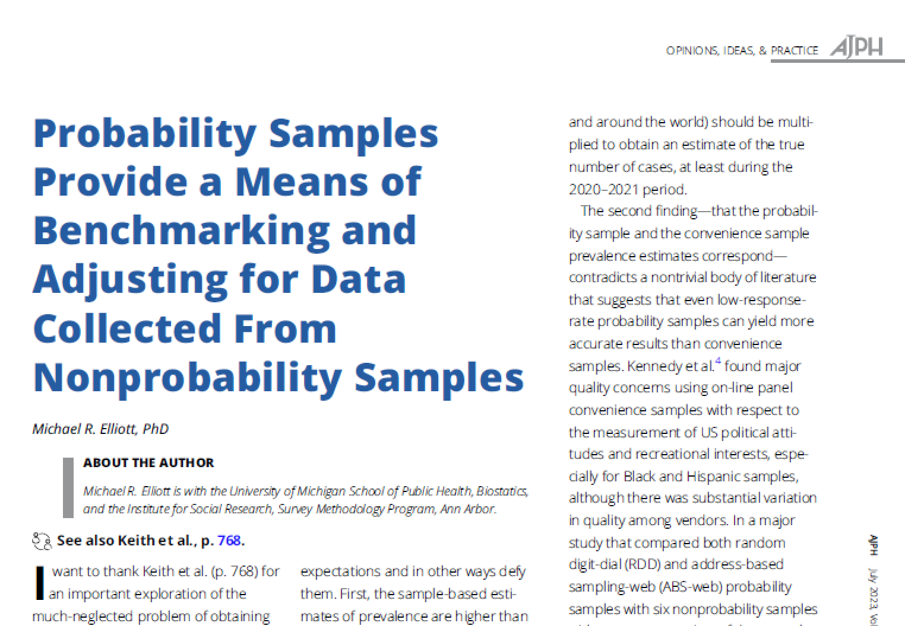
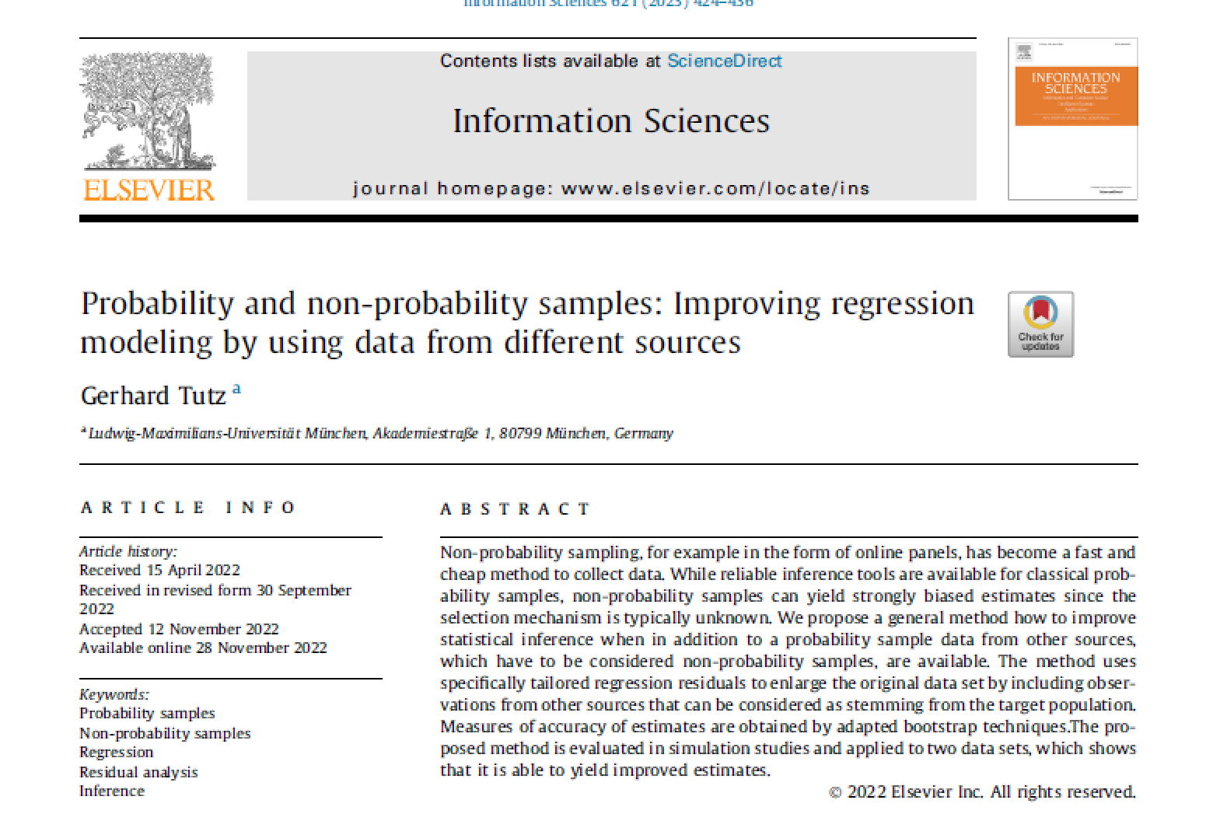
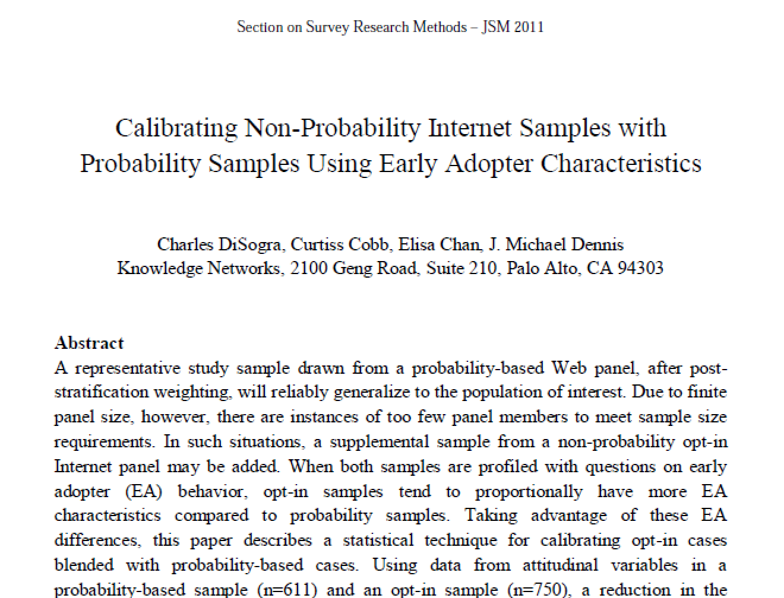
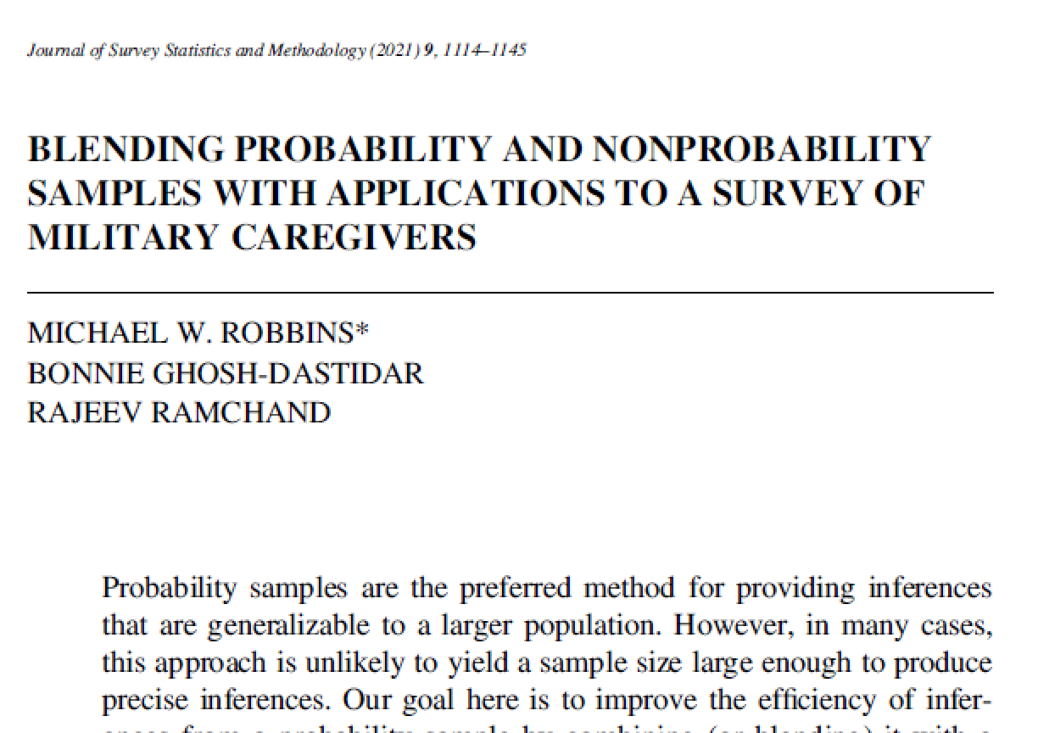
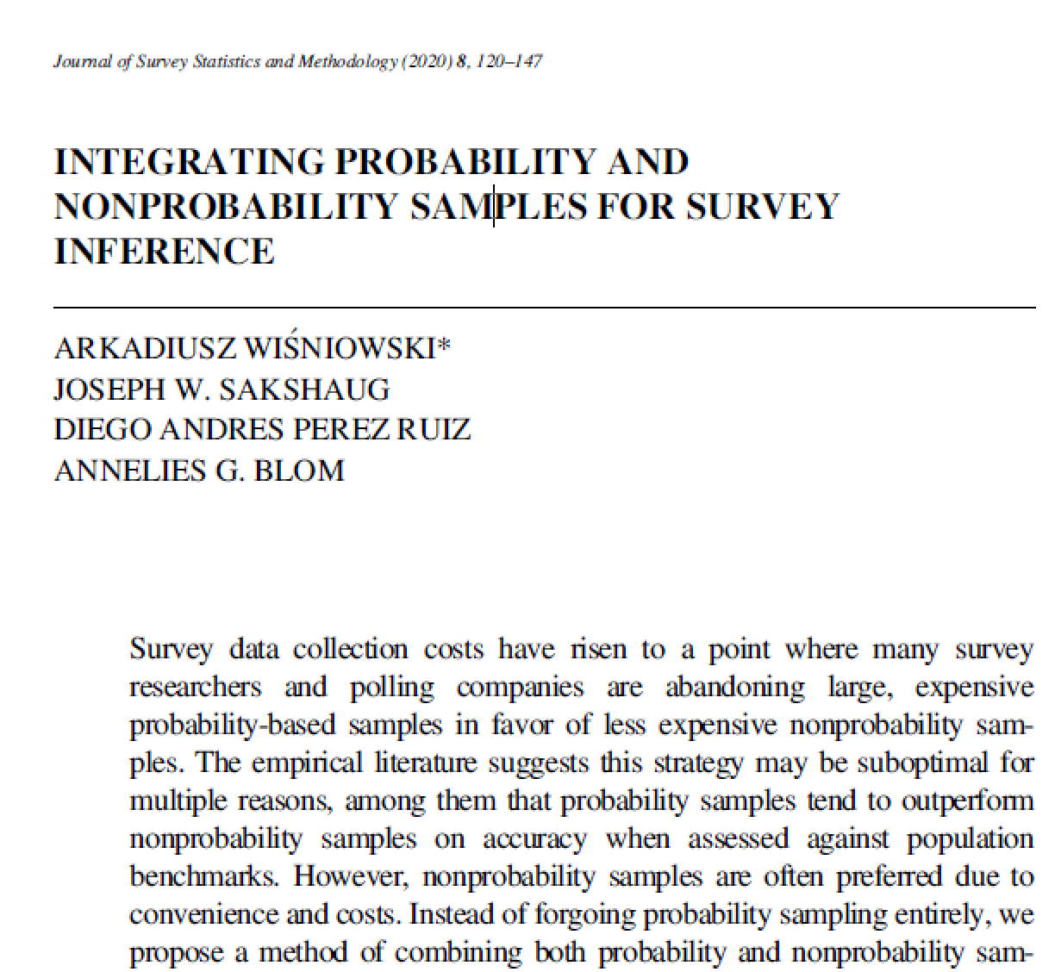

Slide 7

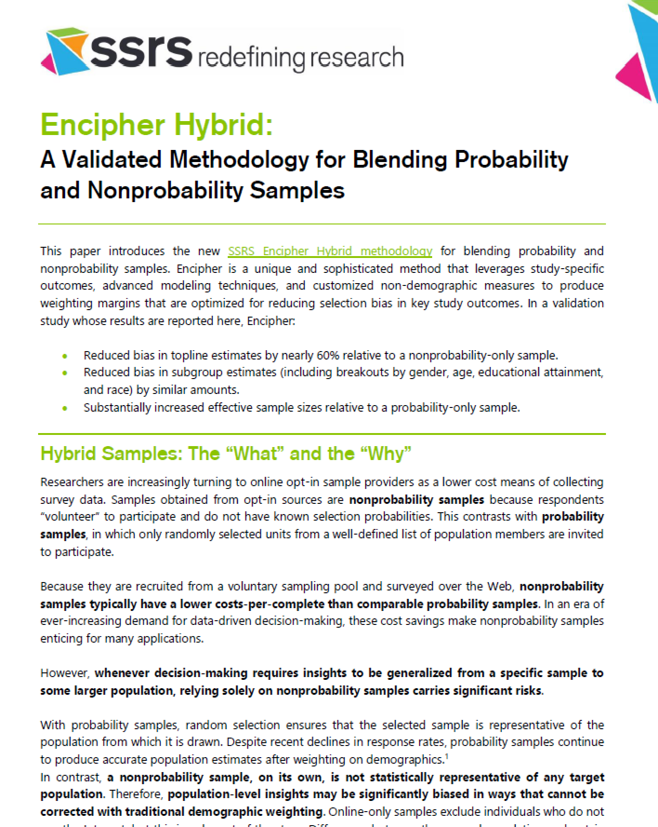



Slide 8
Distributions of variables
Do blended samples accurately reflect correlations between variables?
Do experimental findings differ in blended vs. probability samples?

Slide 9
Distributions of variables
Correlations between variables
Do experimental findings differ in blended vs. probability samples?

Slide 10
Distributions of variables
Correlations between variables
Results of experiments

Slide 11
Data
Survey measuring opinions on global warming and abortion
  More than 100 questions
  Experiment attempting to change abortion attitudes
Probability sample (n=1561)
  Well-established Internet panel
Opt-in panel sample (n=1600)
  Members of a single panel of people who volunteered to complete surveys for money and were purposively selected
Routed sample (n=1553)
  Respondents provided by a mixture of providers

Slide 12
Blended Samples
Post-stratification weighting
Probability + Opt-in
Probability sample
Opt-in sample
Post-stratification weighting
Probability + Routed
Probability sample
Routed sample
Notes:
PROB + OPT-IN BLEND: Probability panel respondents (start with weight1) are combined with the opt-in sample (start with weight=1.0) & weighted be representative of the ages 18+ US population on the same weighting variables as in weight1 (but Internet access is dropped from weighting).
The weights are then trimmed and scaled to sum to the sample size of panel and optin respondents (weight2).
The previous procedure is repeated and additionally weighted on all 5 early adopter (EA) variables (weight2EA).
PROB + ROUTED BLEND: Panel respondents (start with weight1) are combined with the routed sample respondents (start with weight=1.0) and weighted to be representative of the ages 18+ US population on the same weighting variables as in step (1) but Internet access is dropped from weighting. The weights are trimmed and scaled to sum to the sample size of panel and routed respondents (weight3). 5. Step (4) is repeated and additionally weight on all 5 EA variables. The benchmarks of EA variables are based on the weighted panel sample. The weights are trimmed and scaled to sum to the sample size of panel and routed respondents (weight3EA).

Slide 13
Distributions of variables
Correlations between variables
Results of experiments

Slide 14
Accuracy of distributions
28 benchmarks (modal category)
Secondary demographic variables (n=5)
Non-demographic variables (n=23)
Reproduced from MacInnis et al. 2018
Notes:
Secondary demographics:
married, citizenship, armed forces, height, weight
Non-demographics:
volunteering, food allergies, walk or bike, vigorous recreational activities, moderate recreational activities, donated blood, sleep, emergency room visits, asthma, high blood pressure, surgery, saw doctor, diet, checked blood pressure, general health, times move in past 5 years, air-conditioning, fire extinguisher, kitchen sink, repairs and maintenance, grocery shopping expense, meal expense, free food, mass transportation

Slide 15


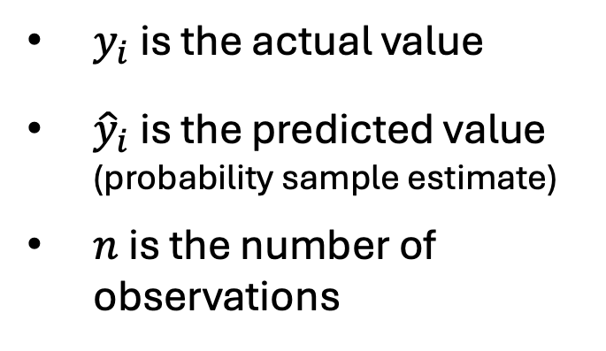
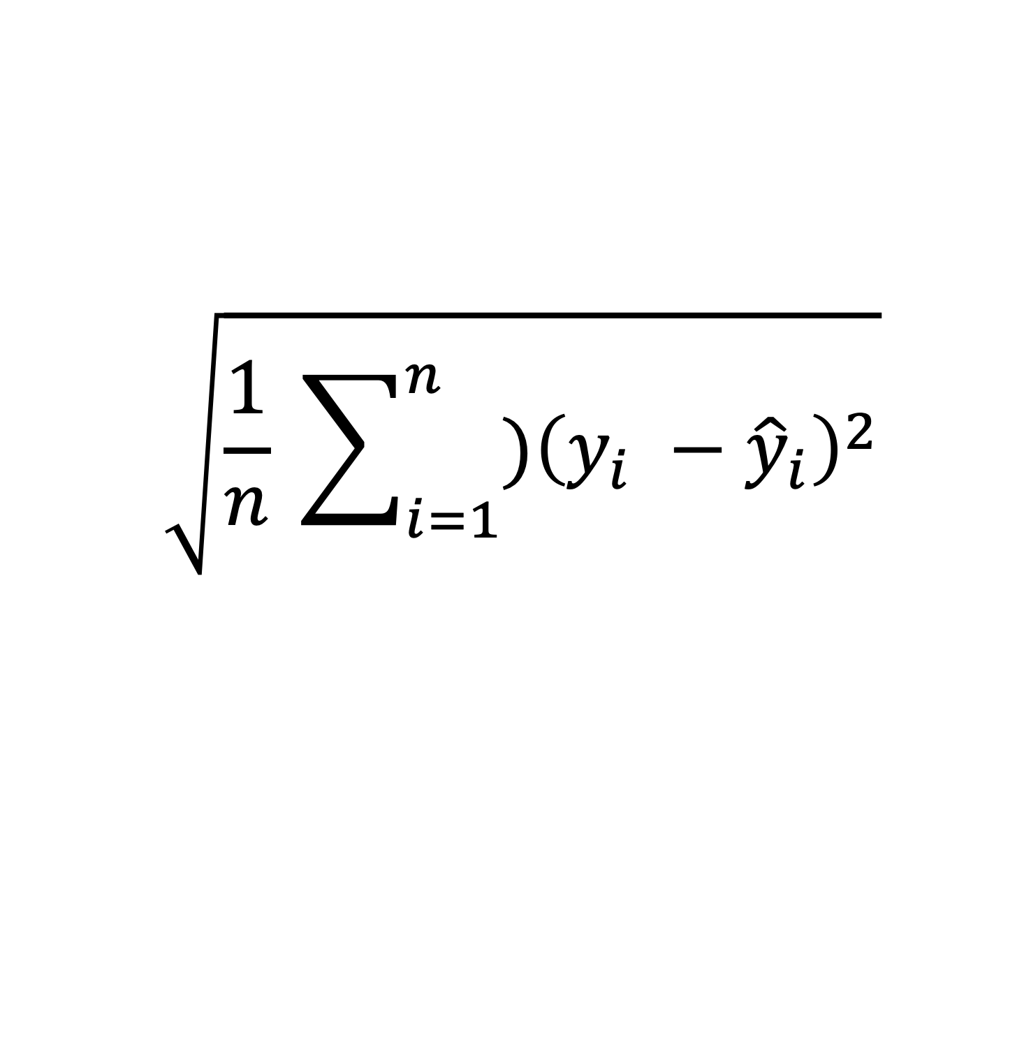
Root Mean Squared Error
$$\sqrt{\frac{1}{n} \sum_{i=1}^{n}{{)\left(y_{i} −{\hat{y}}_{i}\right)}^{2}}}$$
$y_{i}$ is the actual value
${\hat{y}}_{i}$ is the predicted value (probability sample estimate)
$n$ is the number of observations
Reproduced from MacInnis et al. 2018
Notes:
The RMSE is the square root of squared errors (deviation of the percent of respondents in a modal survey category from the percent of the population in that category) averaged across measures. Unlike the simple averaging done in many studies in the past, the RSME penalizes large errors more than small ones.
This approach is valuable for the following reason:
Consider two surveys with the identical mean absolute error. One survey has a few very large errors, a few very small errors, and otherwise moderate errors. Another survey has errors that are about equal to one another across comparisons. The RMSE for the former survey will be much larger than that for the latter survey. Extreme errors in a few measures can be especially costly for a researcher.

Slide 17
% of respondents in the modal category
46 questions
Global warming and abortion

Slide 18

Examples of questions (not exact wordings)
Will global warming be good, bad, or neither?
How important is the issue of abortion to you personally?
How much do you think global warming will harm you personally?

Slide 19
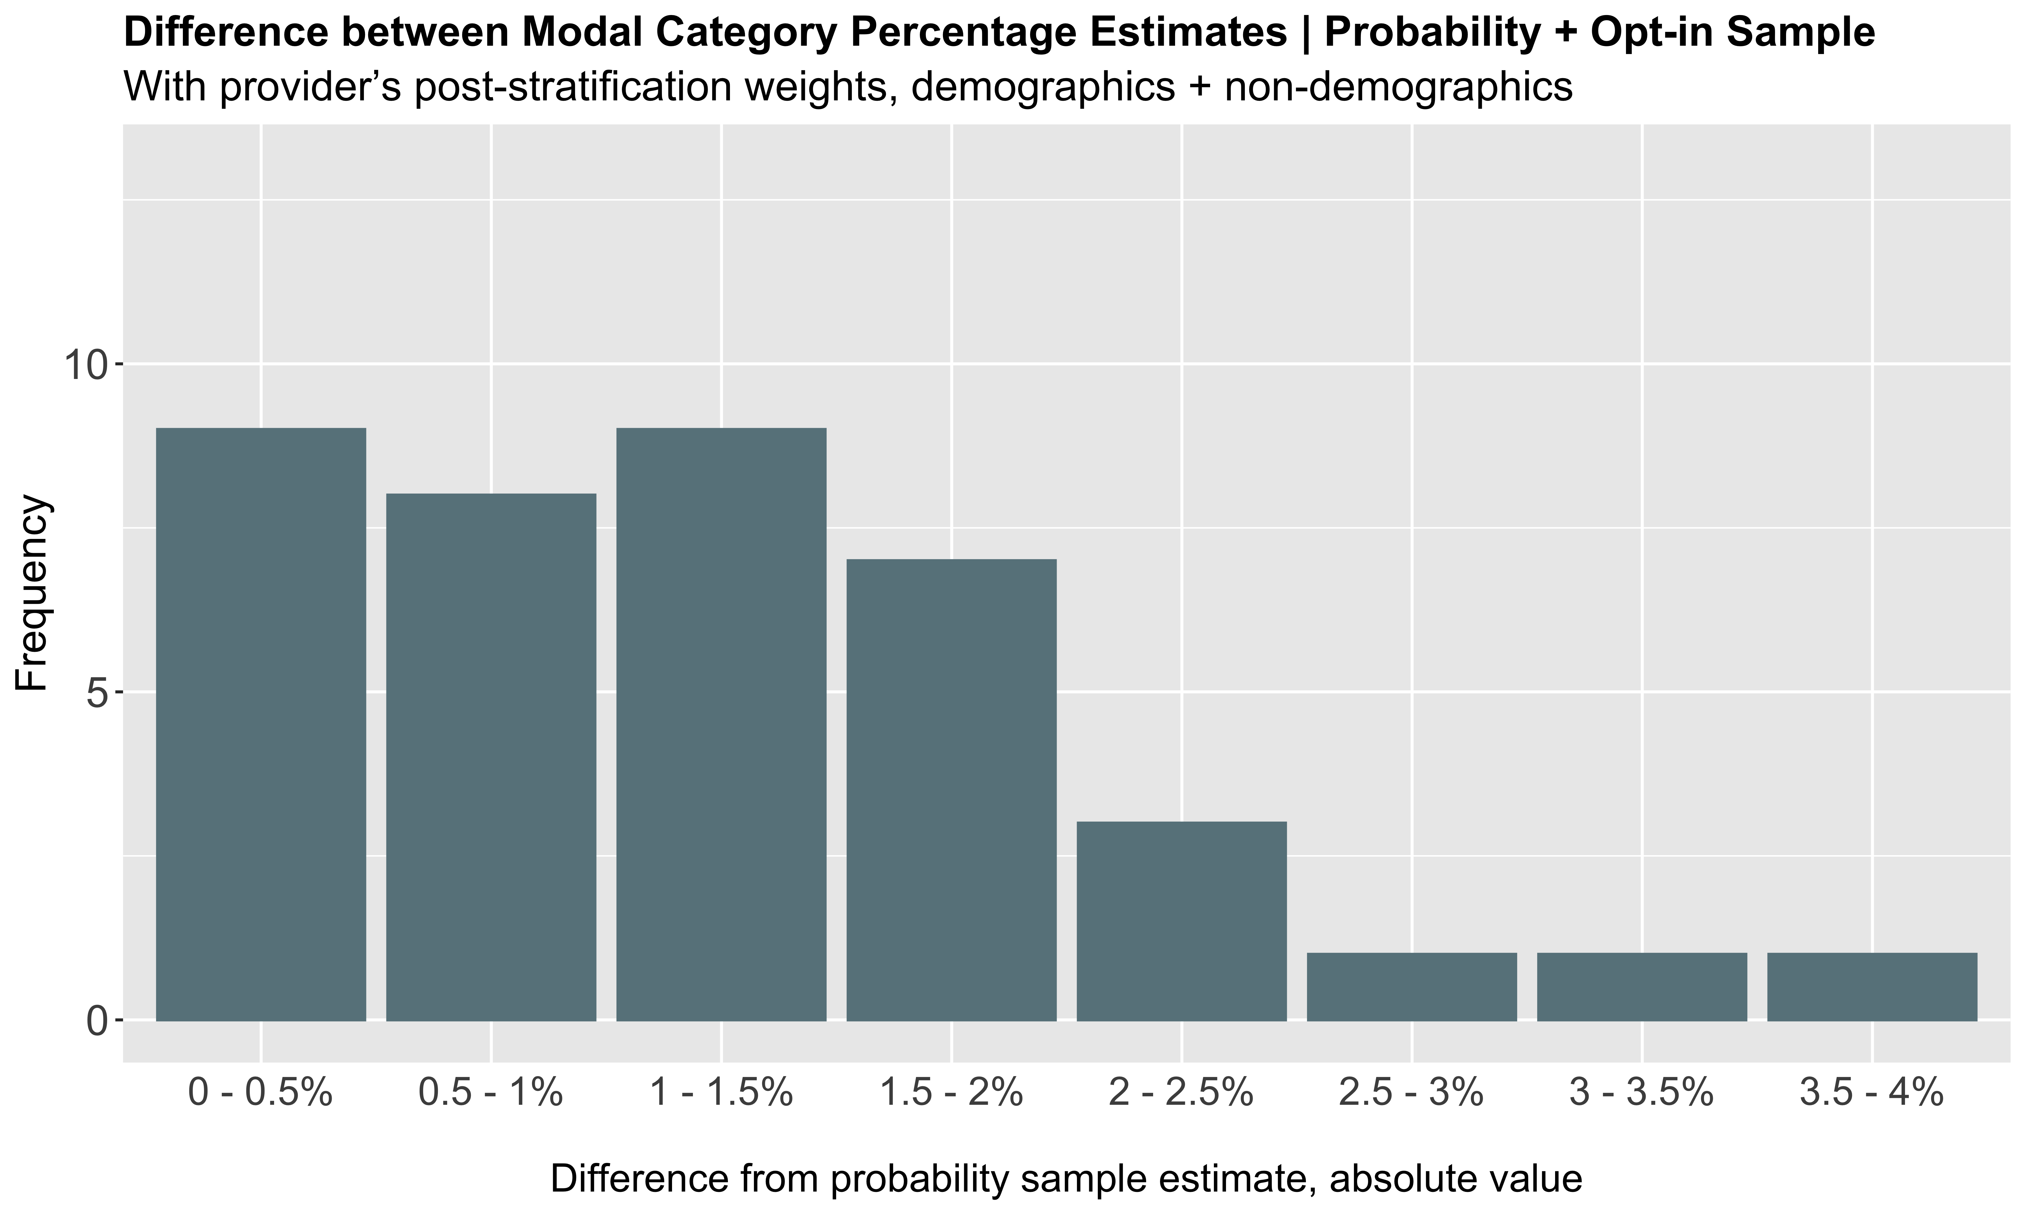

Slide 20
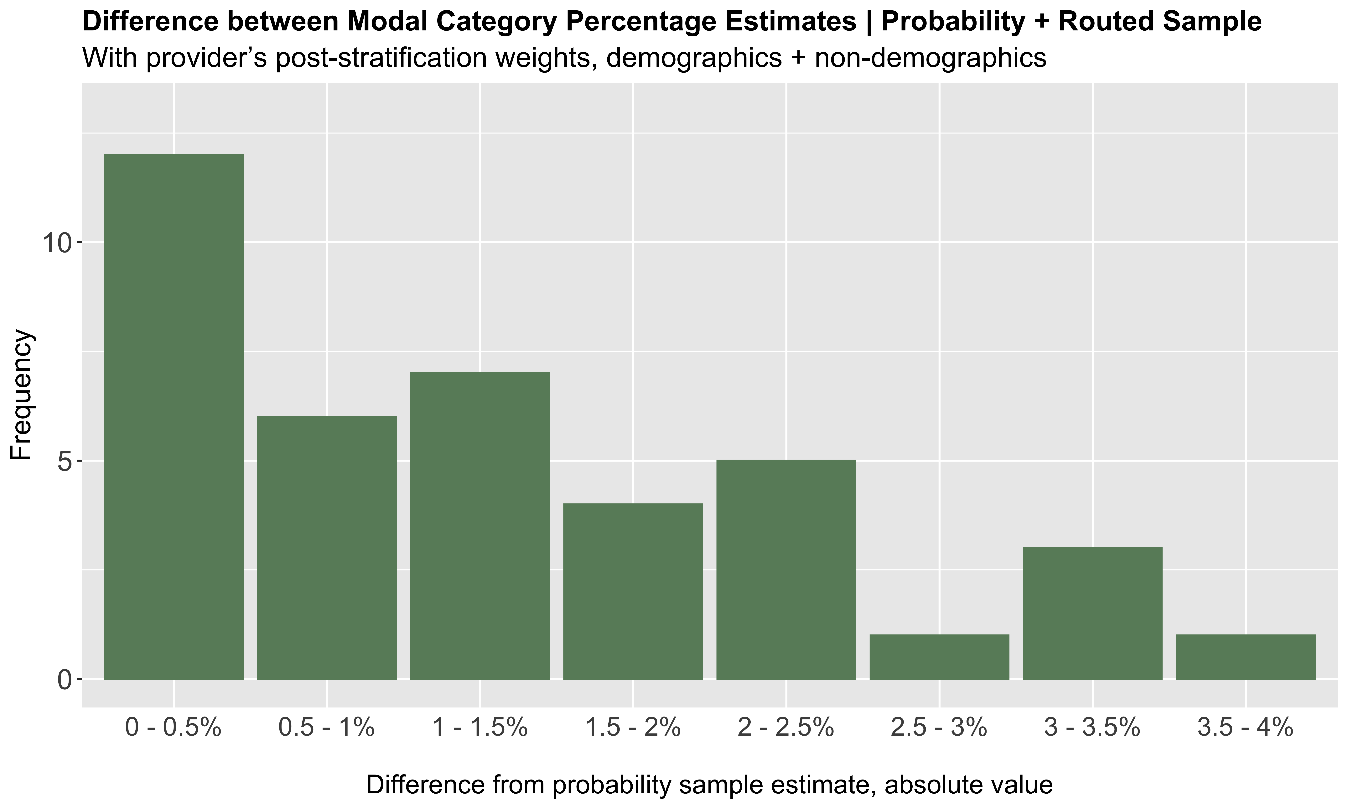

Slide 21
Distributions of variables
Correlations between variables
Do experimental findings differ in blended vs. probability samples?

Slide 22
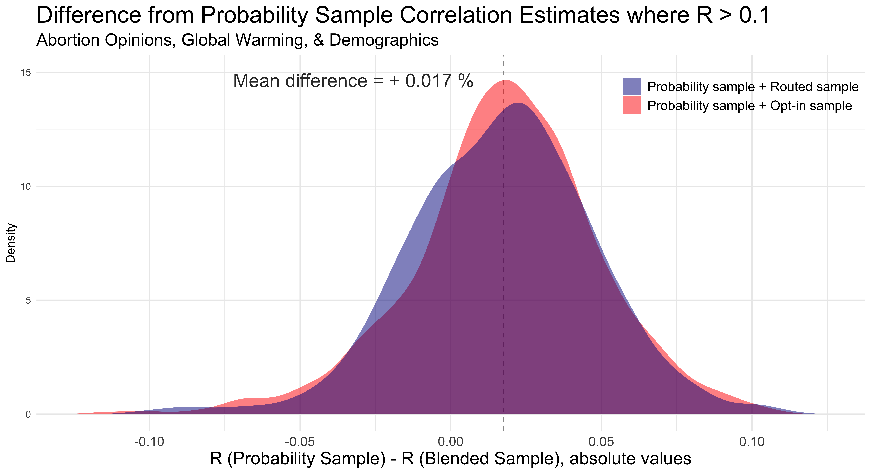
1,840 n correlations included
Notes:
Process for creating this graph:
For each sample type (GfK probability, Probability + opt-in, Probability + routed), I created correlation matrices for key demographic variables (women, education, income, Hispanic, white, black, asian) and for all 1) global warming questions and 2) all abortion outcome questions in the 2012 survey.
Next, I got the absolute value of these correlations. Then, I subtracted the the absolute value of the probability + opt-in sample correlations from the GfK probability sample correlations; I then did the same for the probability + routed sample. Only correlations at or above R of 0.1 were included.
After removing any duplicate correlations from these matrices, I aggregated these differences into one data frame with a corresponding variable to track whether each row (absolute difference correlation value) corresponds to the Probability + opt-in sample or the Probability + routed sample.
Finally, I overlaid the density plots of these correlation differences, with light red for the Probability + opt-in sample and light blue for the Probability + routed sample.

Slide 23
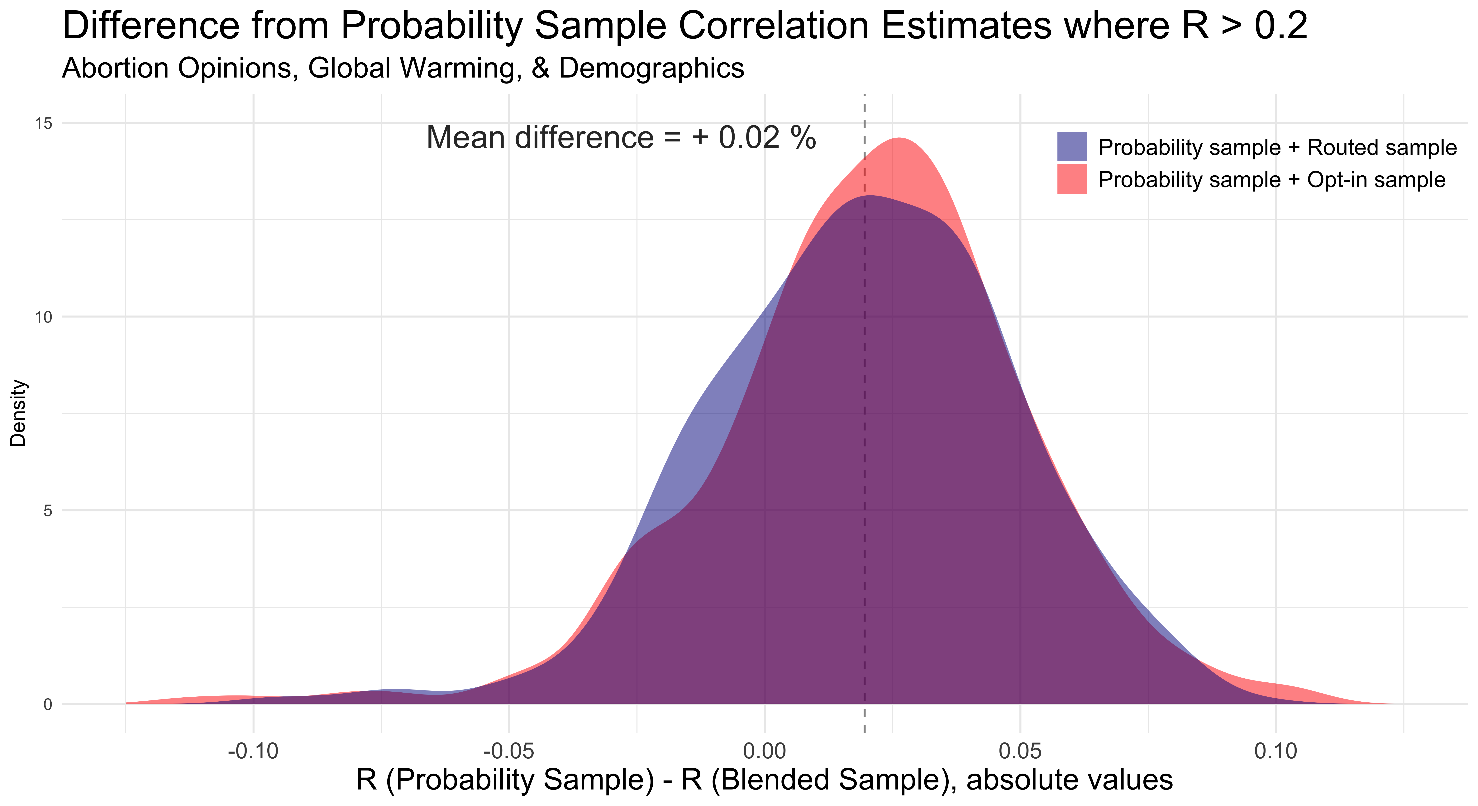
1,016 n correlations included
Notes:
Same method as the previous graph, but just removed any correlations at the beginning which did not meet or exceed R = 0.20 within the GfK probability sample.

Slide 24


Correlations $(R$) between questions
$$R_{prob}≥R_{blend}$$
86

Slide 25
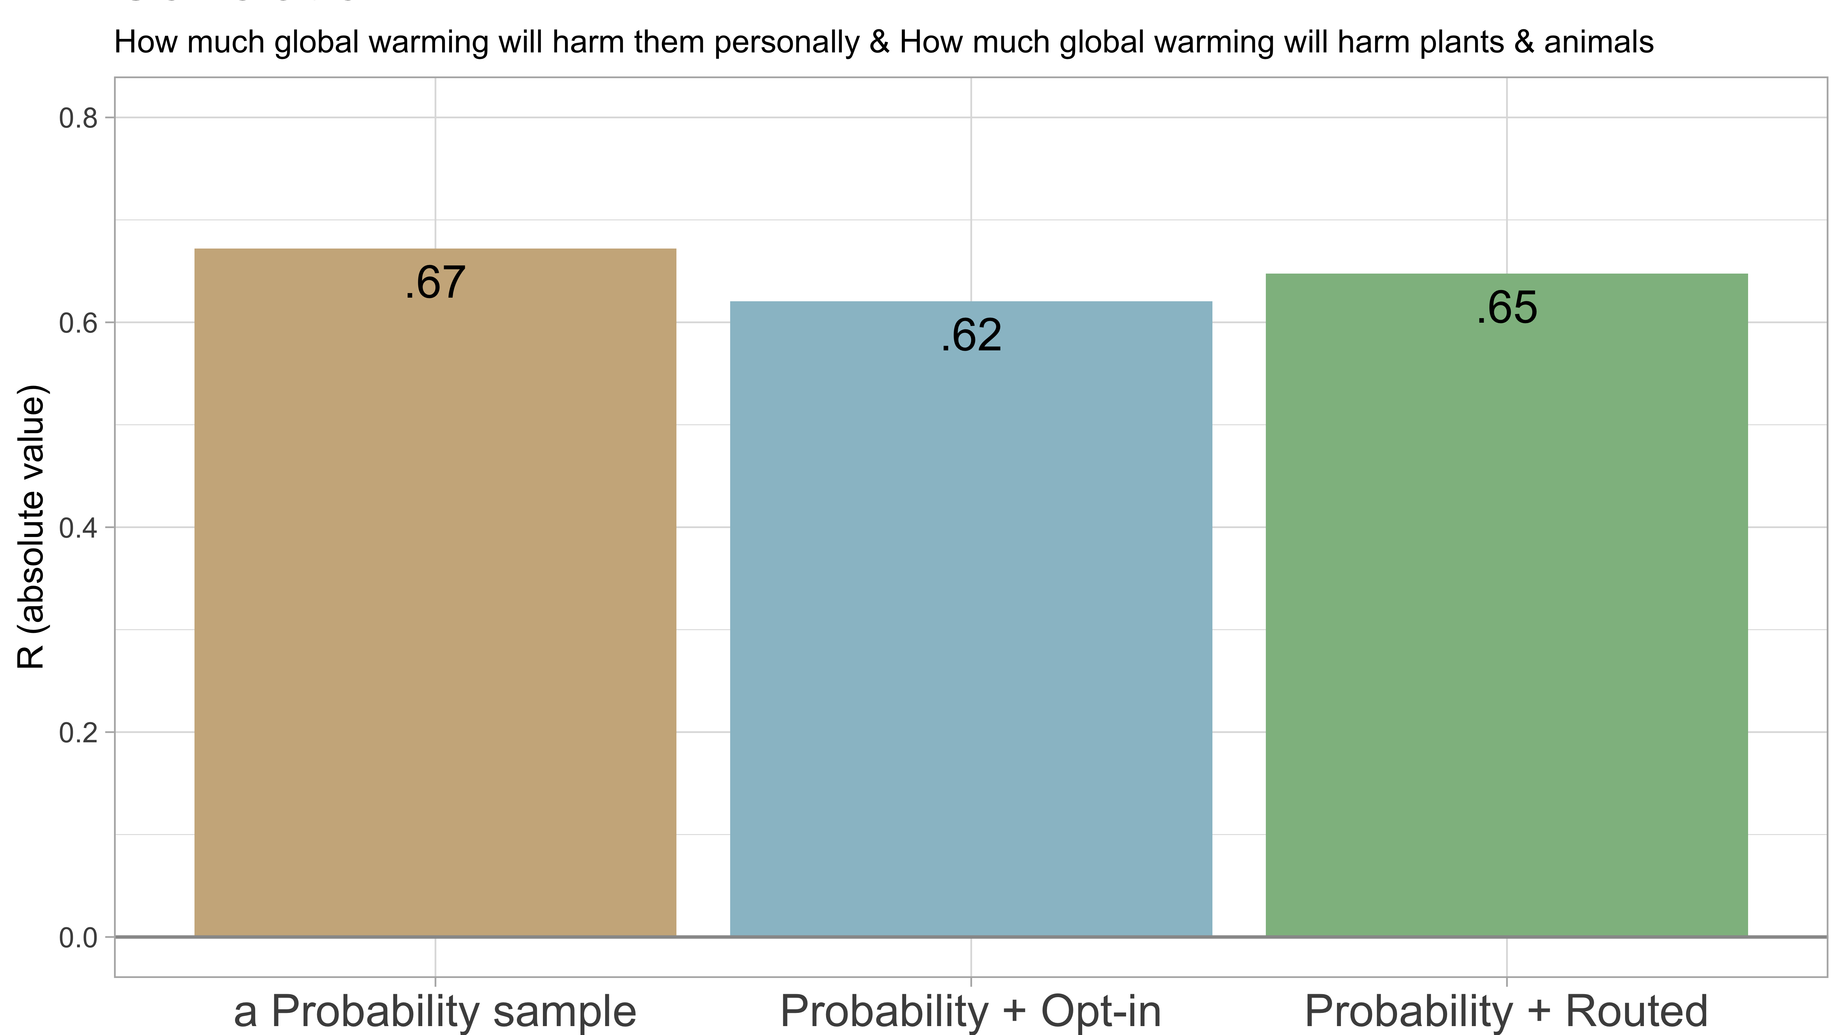

Slide 26
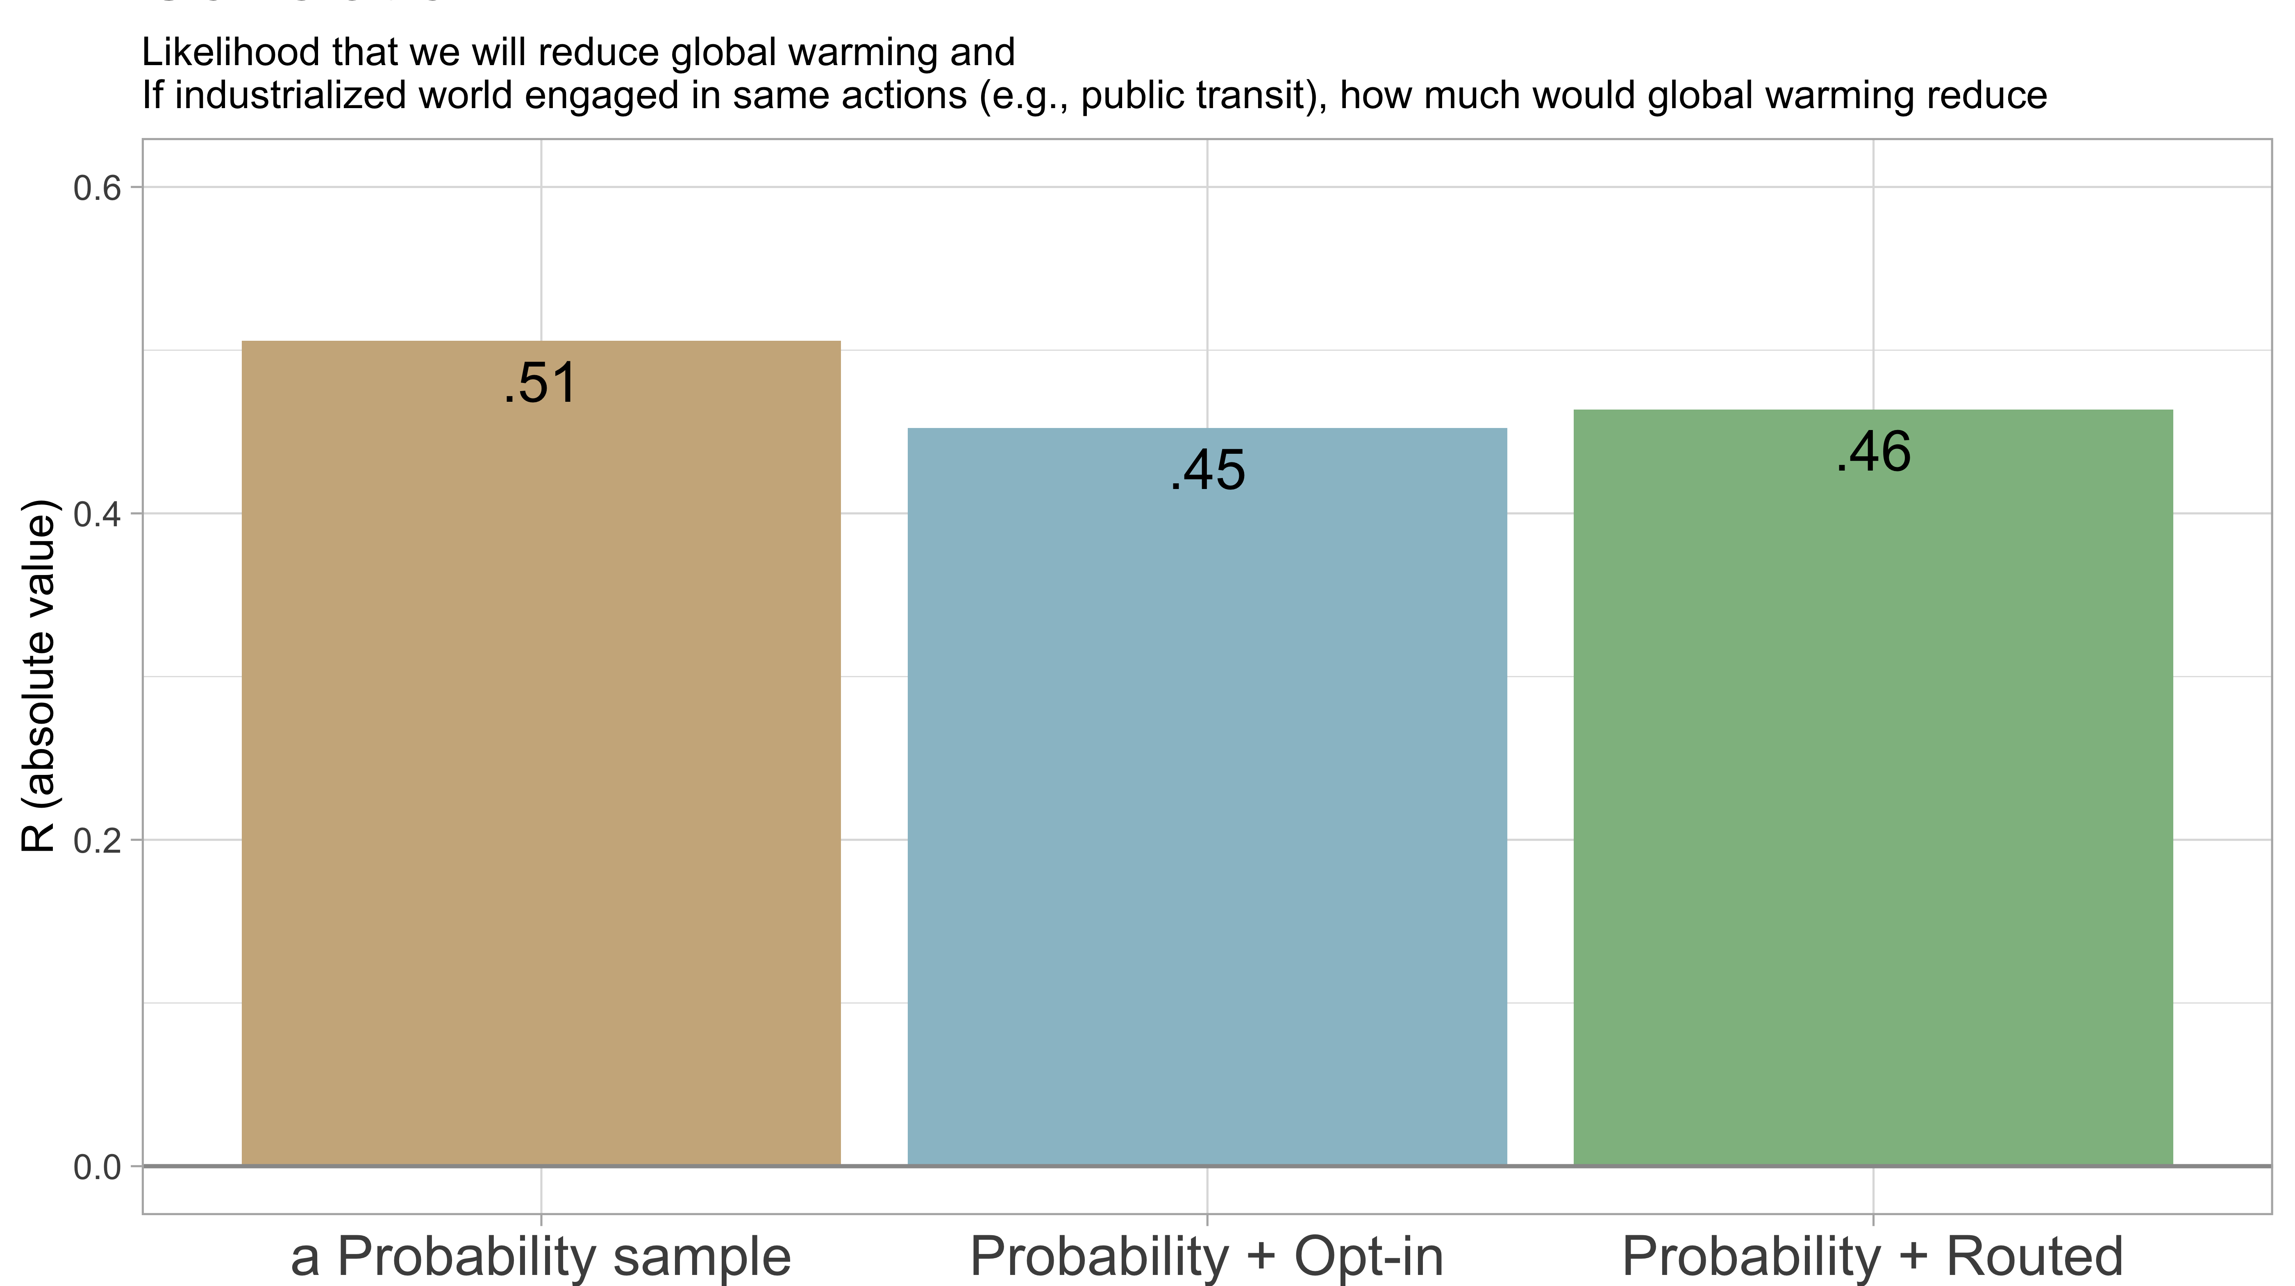

Slide 27
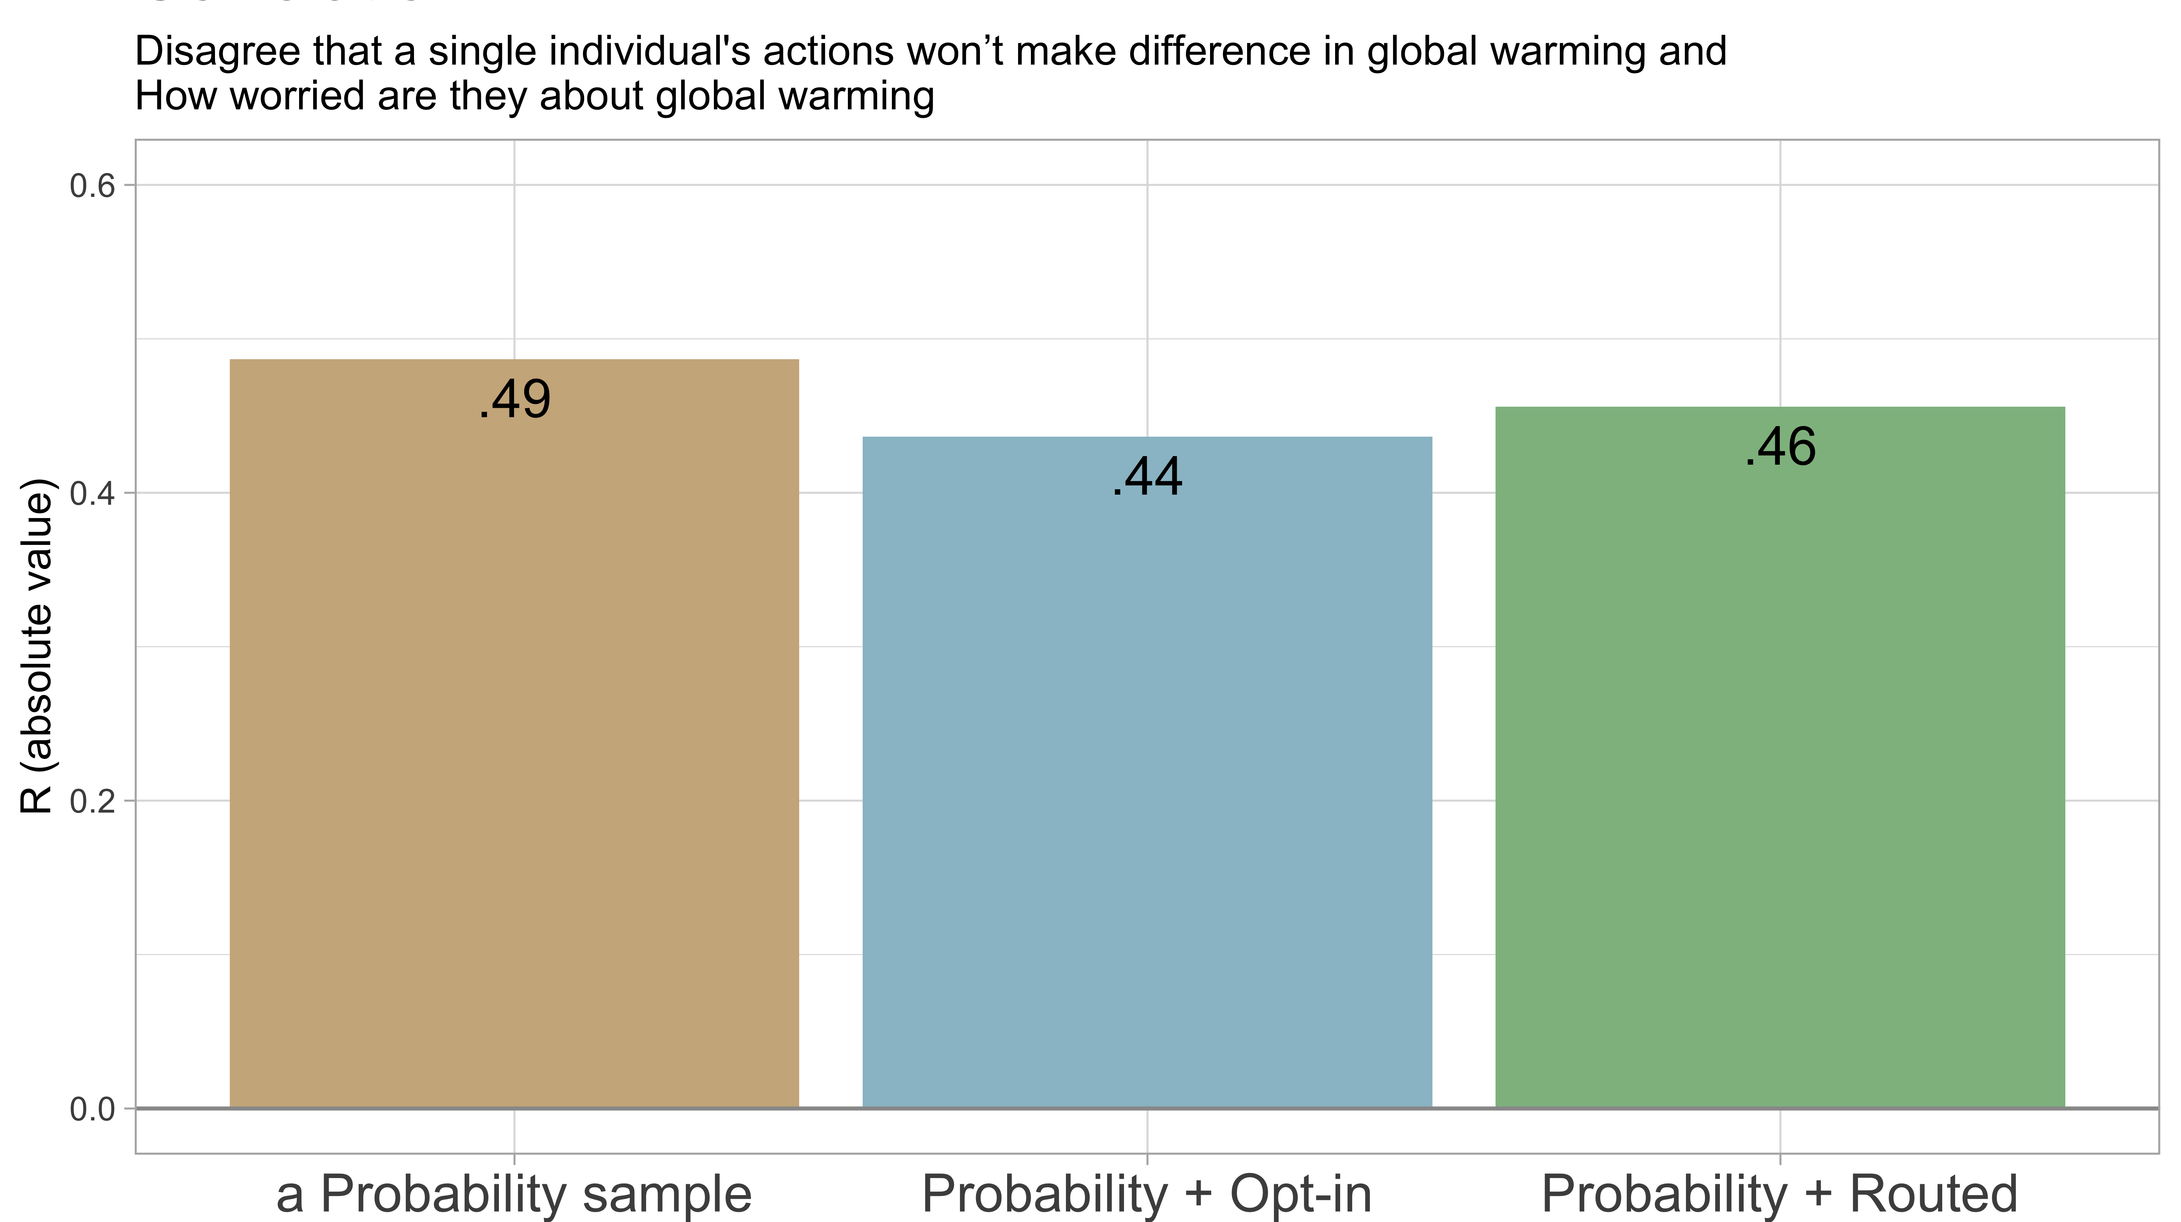

Slide 28
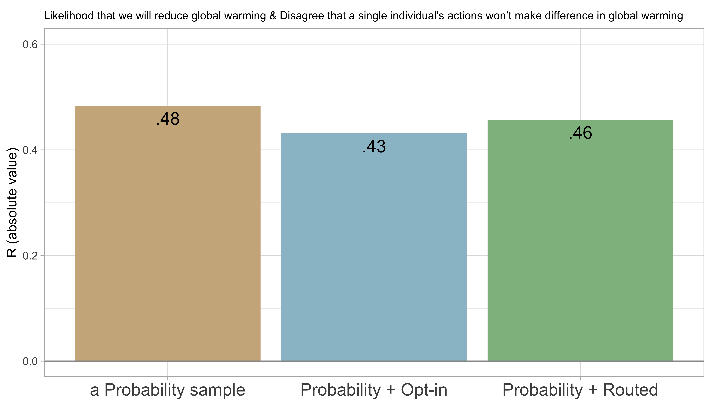

Slide 29
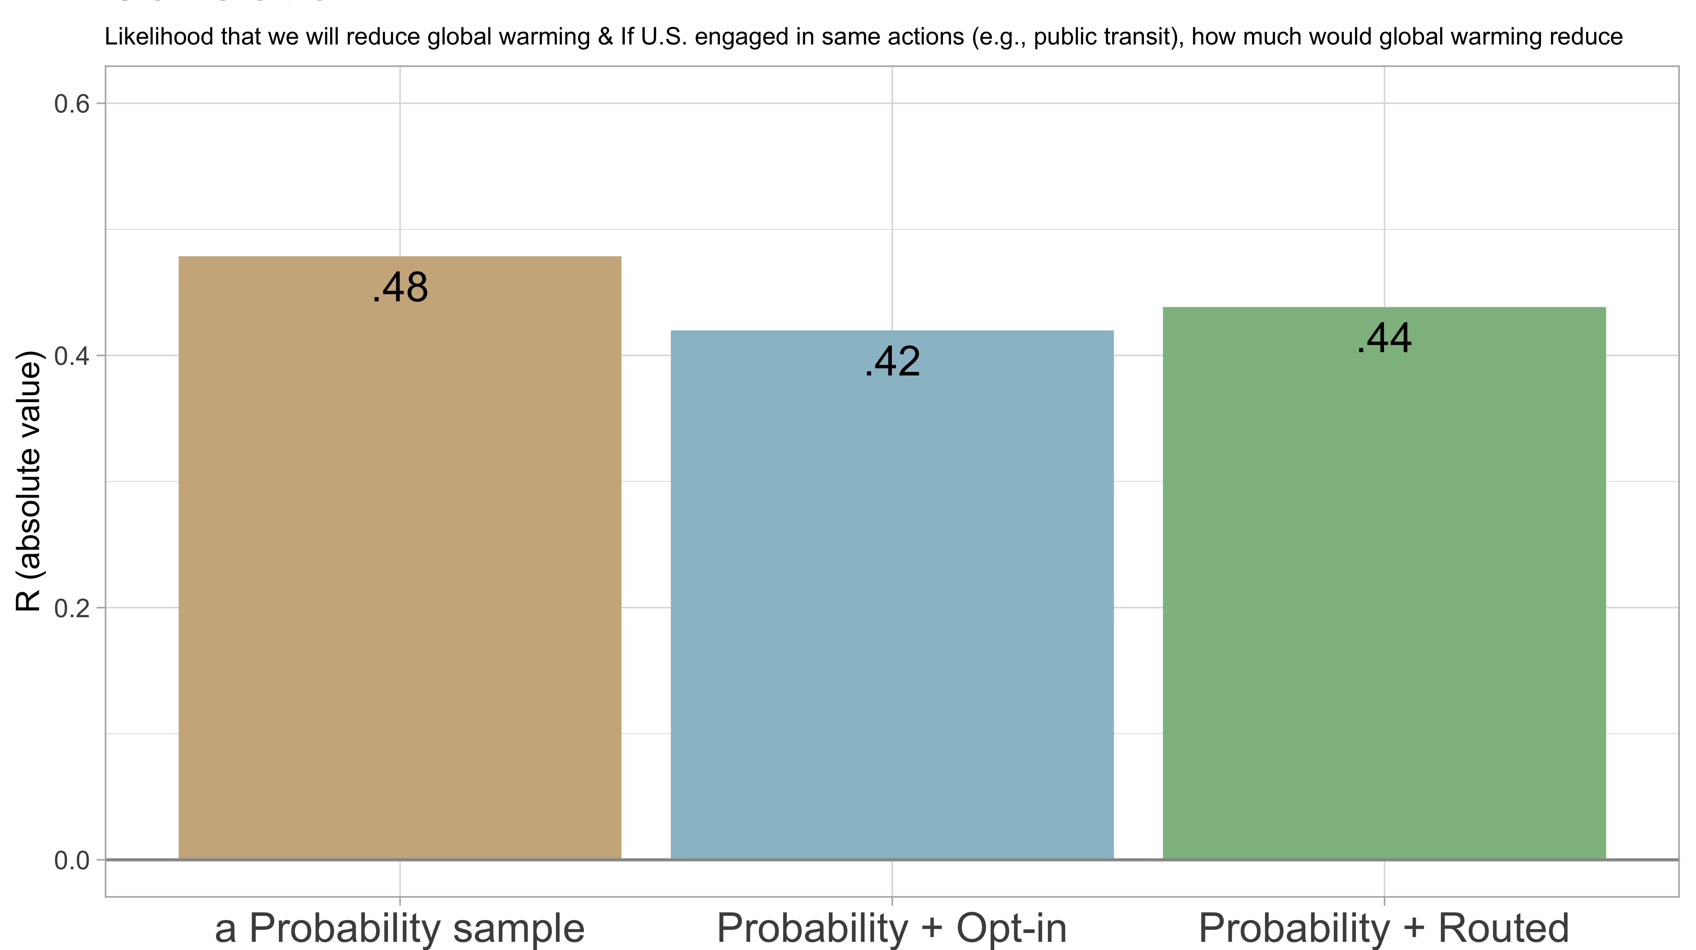

Slide 30
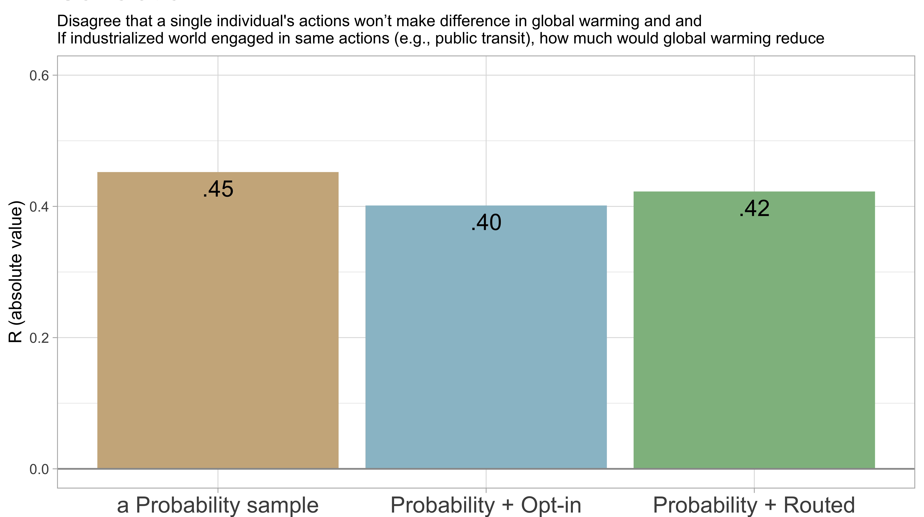

Slide 31
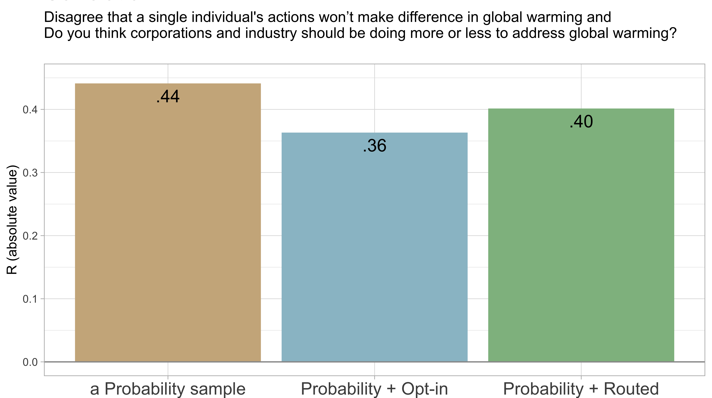

Slide 32
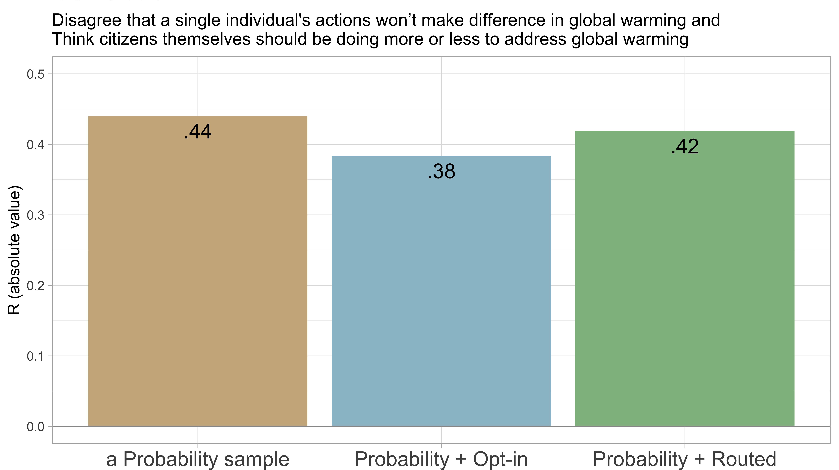

Slide 33
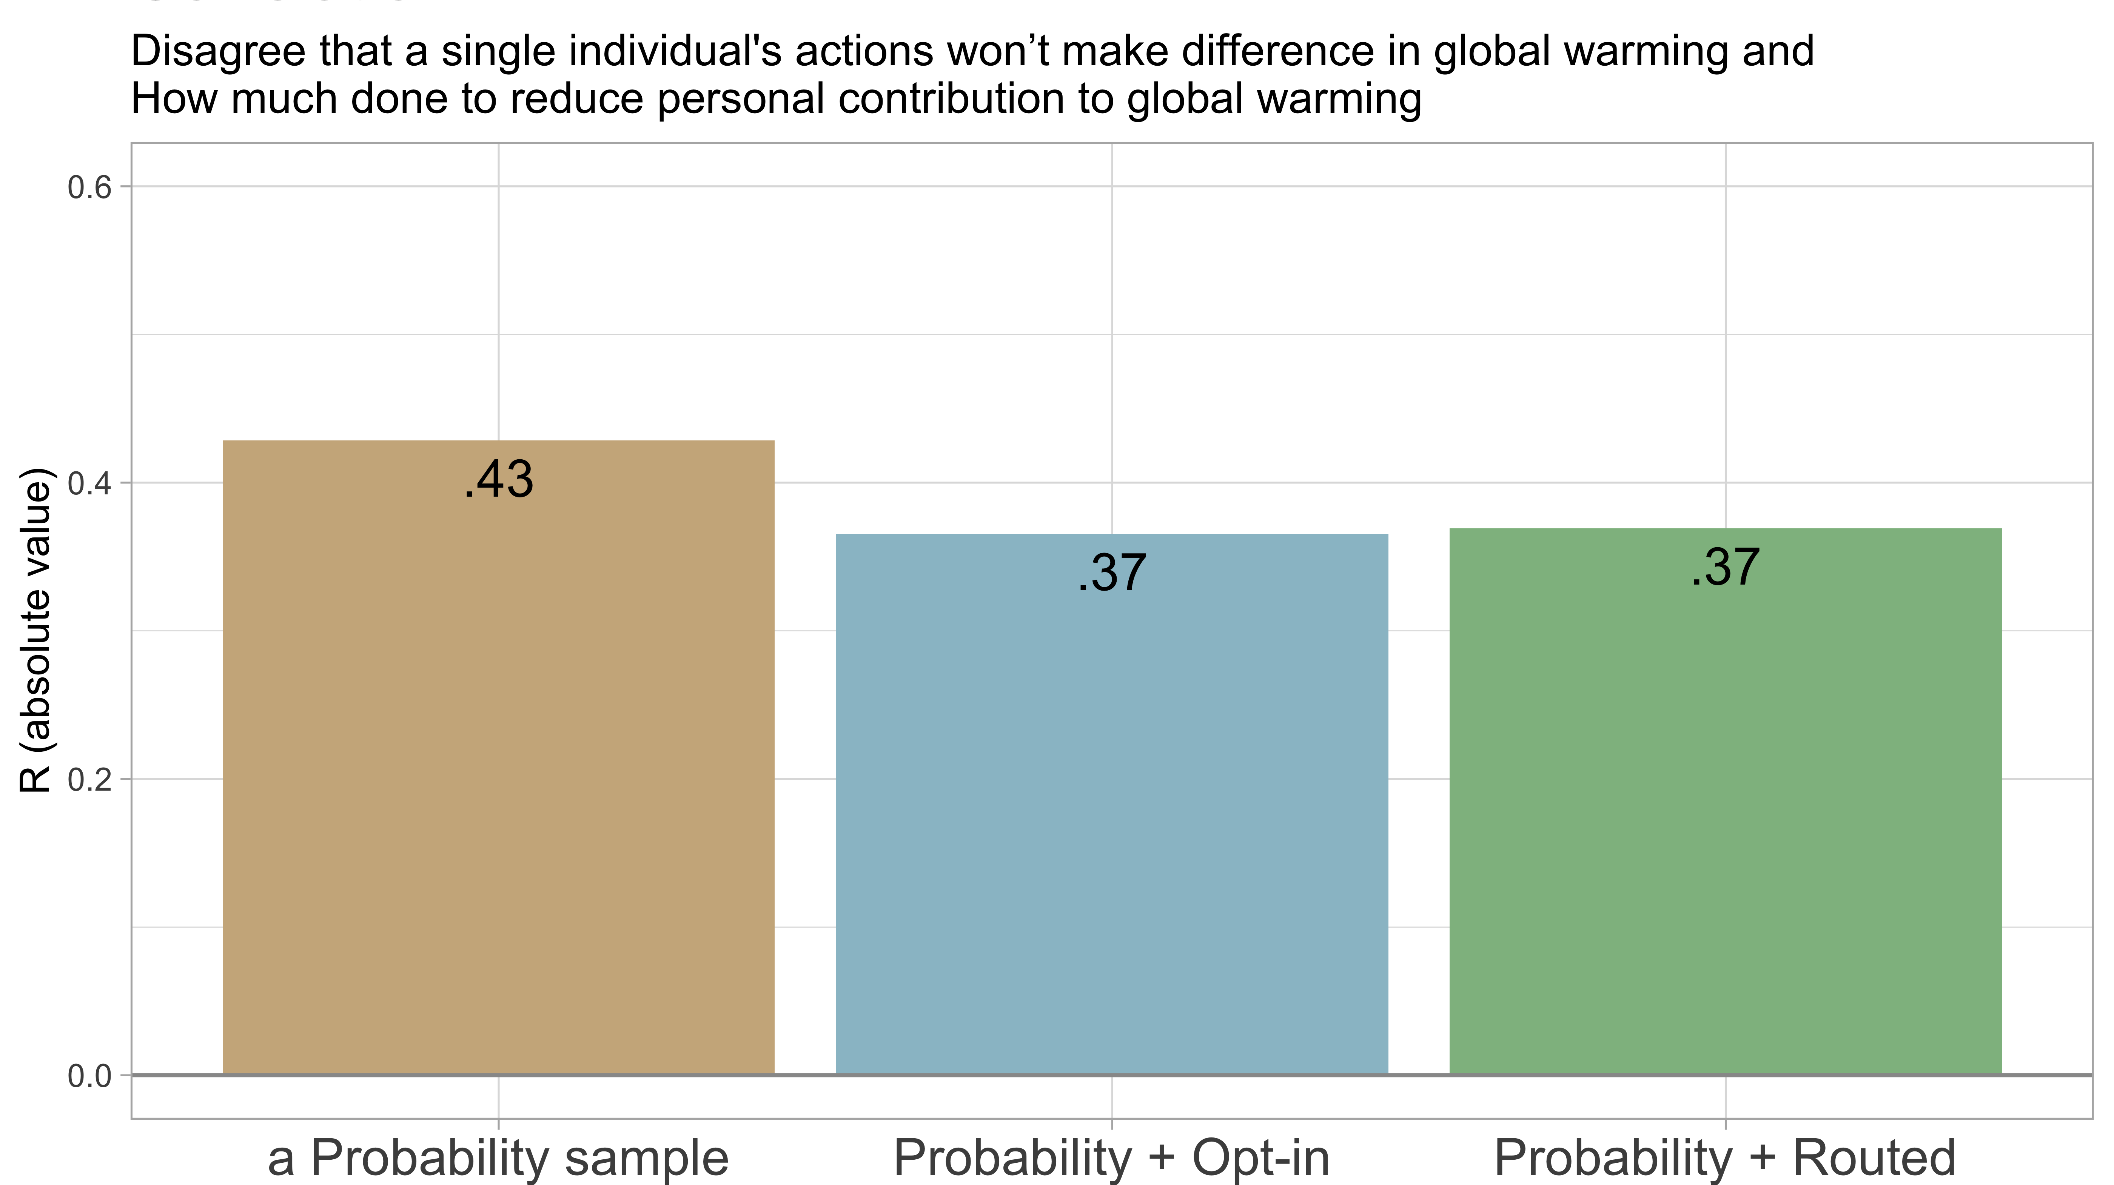

Slide 34
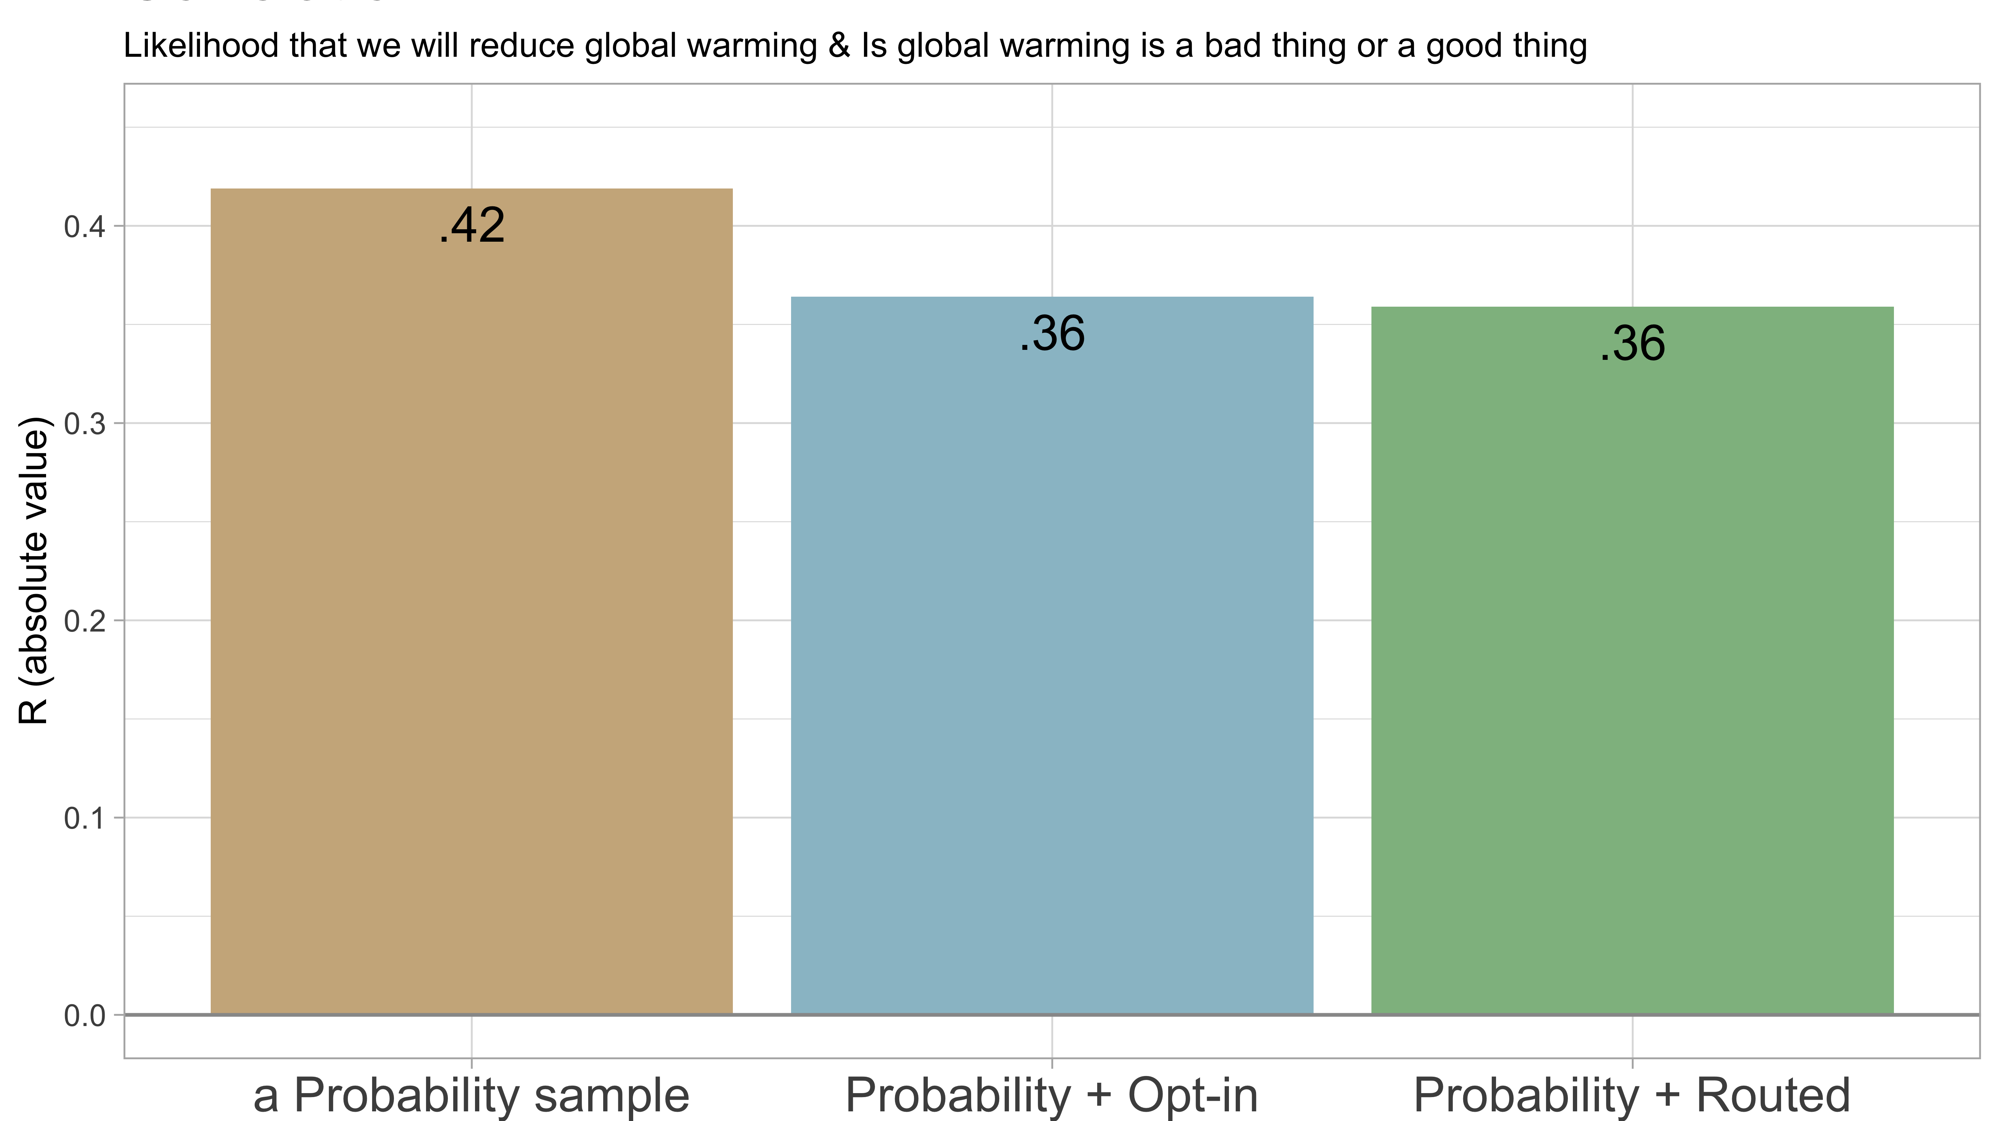

Slide 35
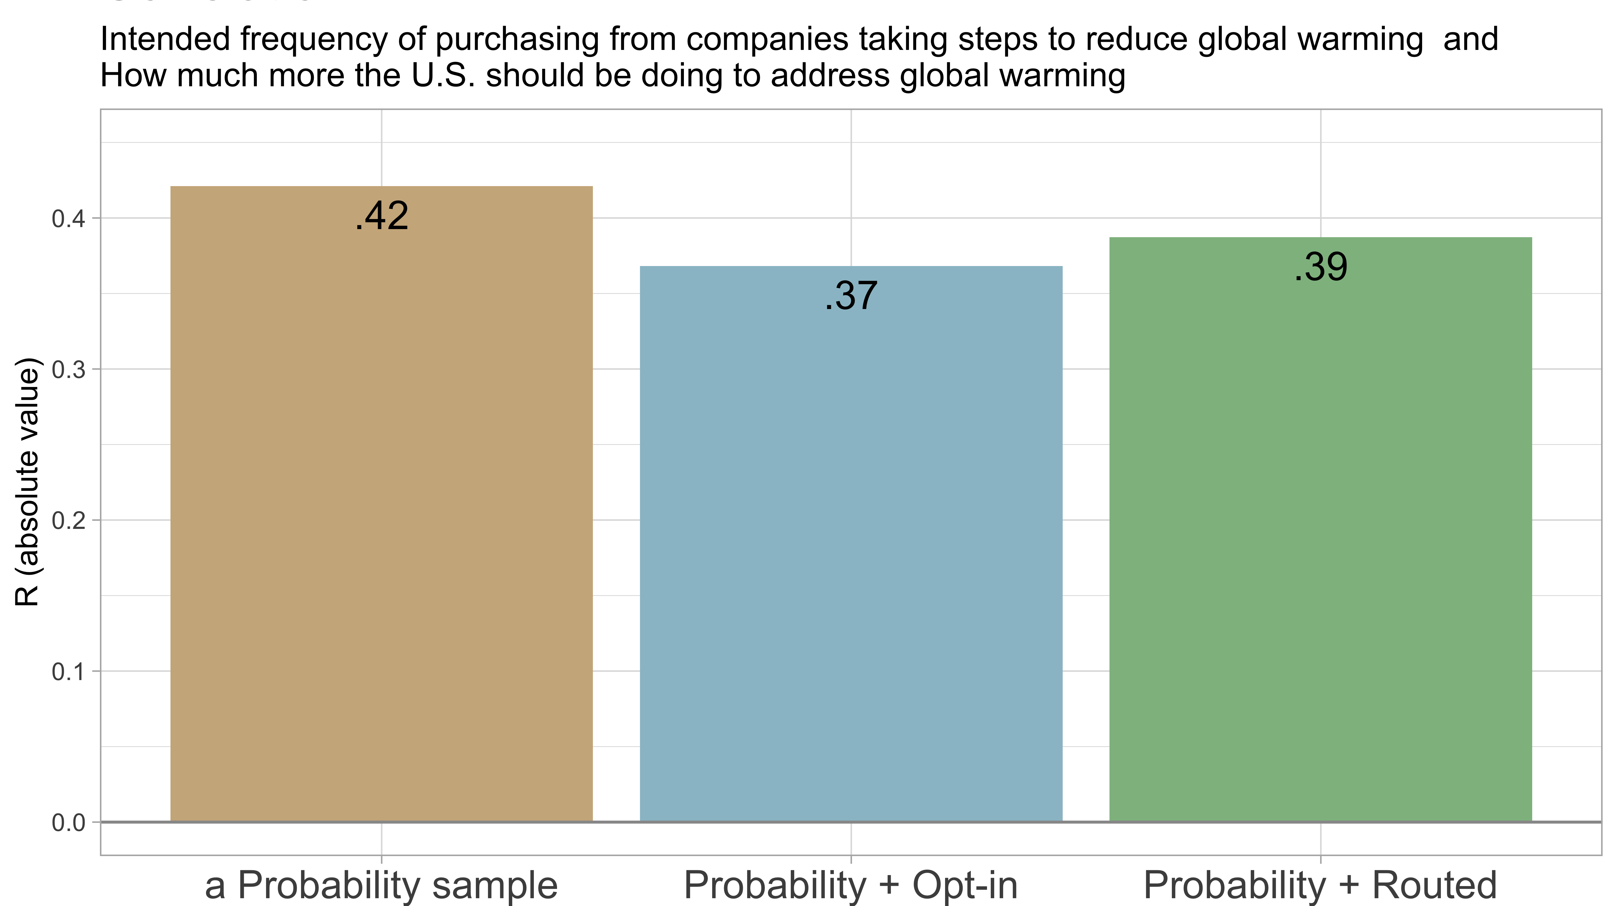

Slide 36
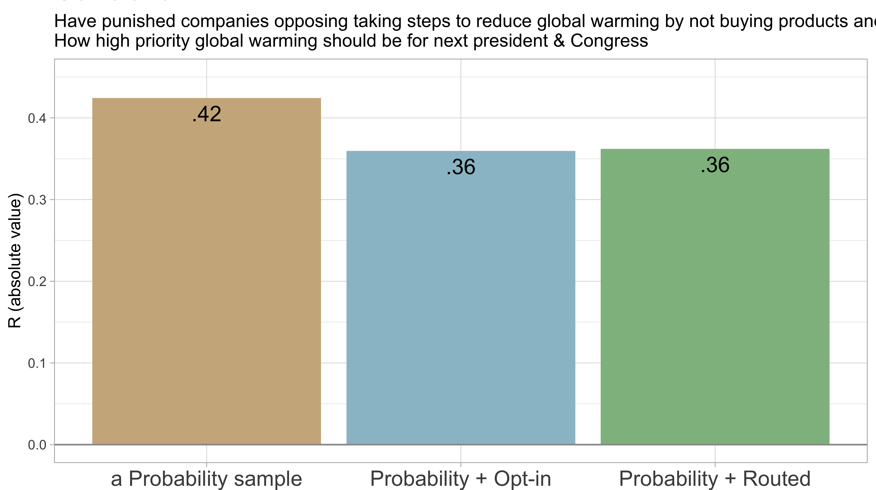

Slide 37
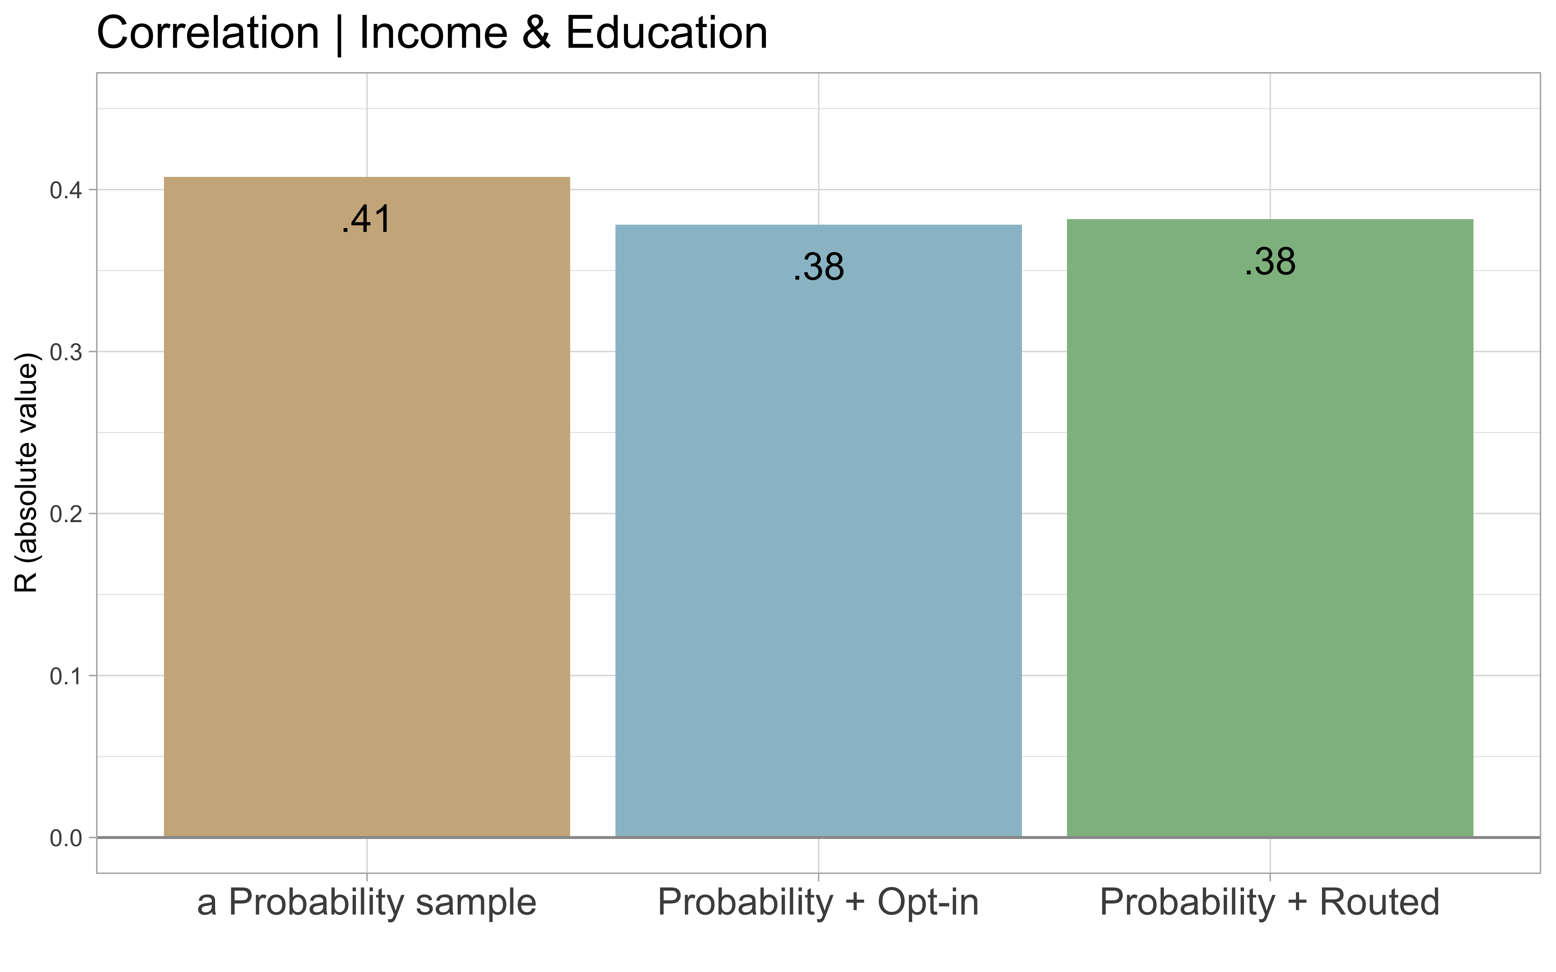
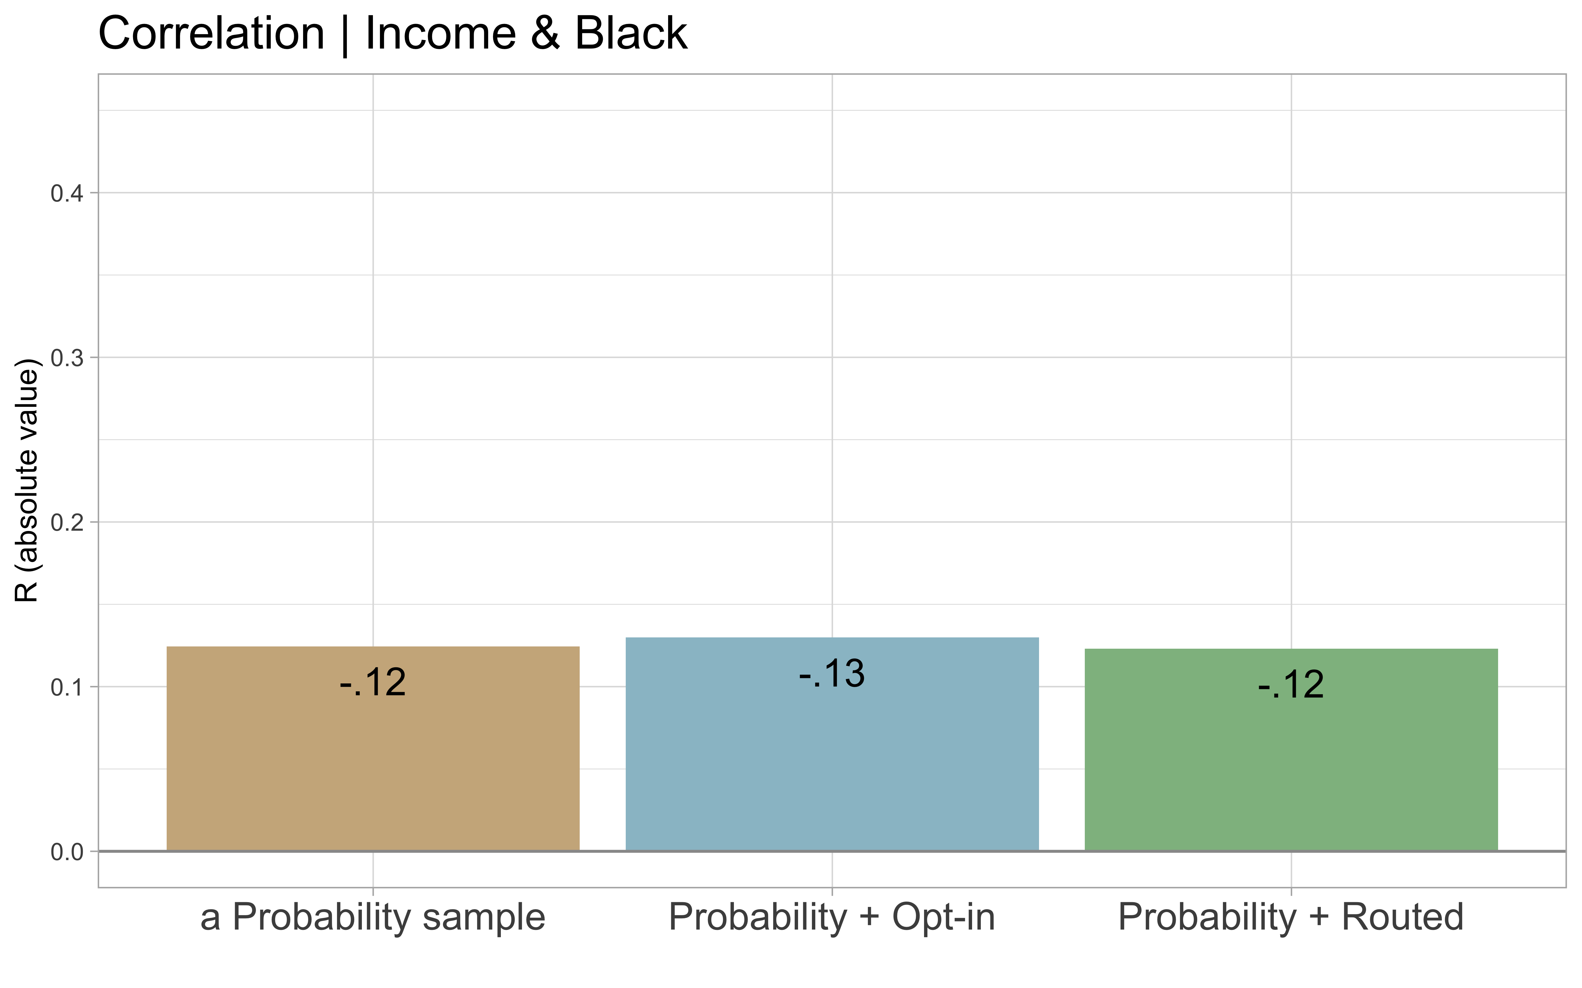

Slide 38
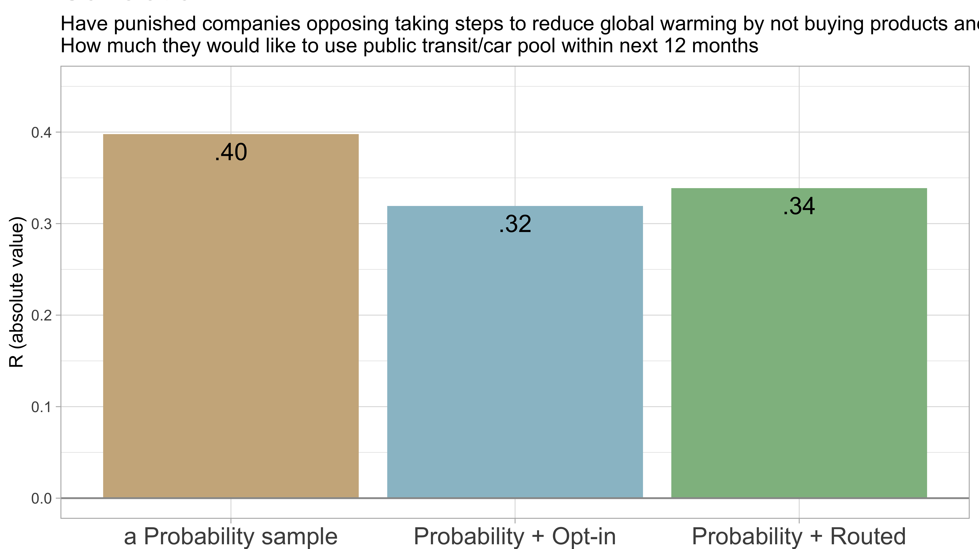

Slide 39
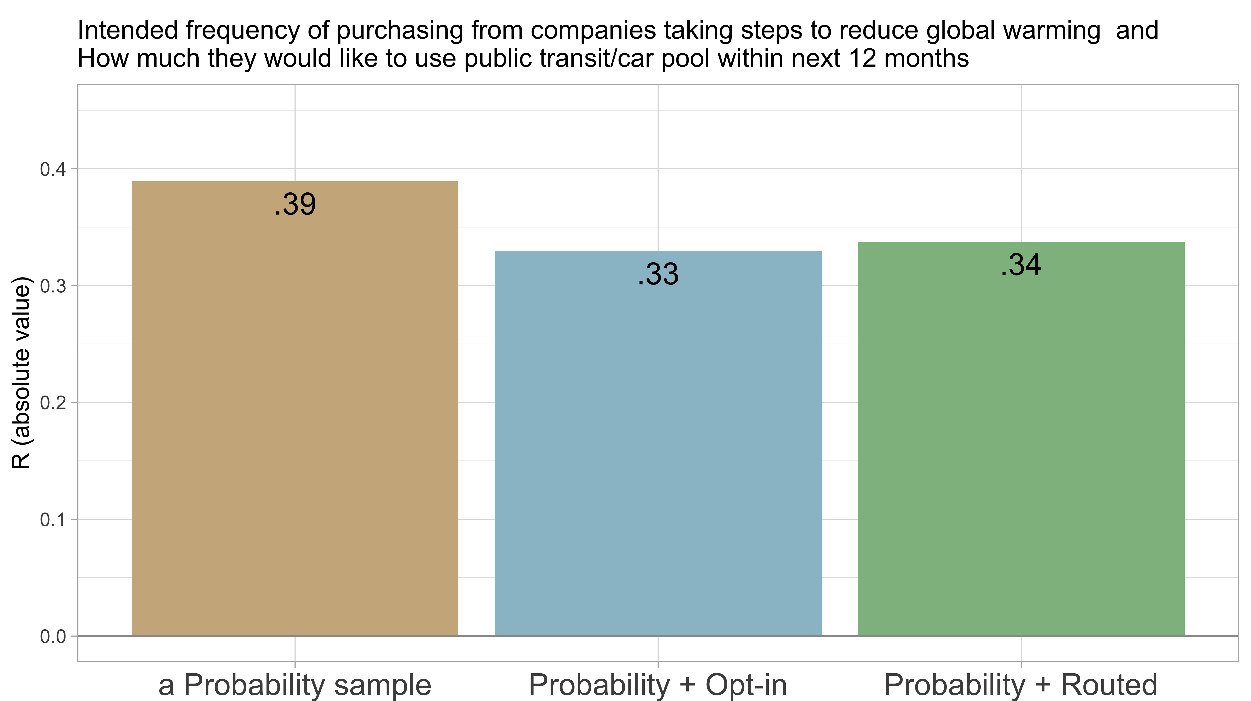

Slide 40
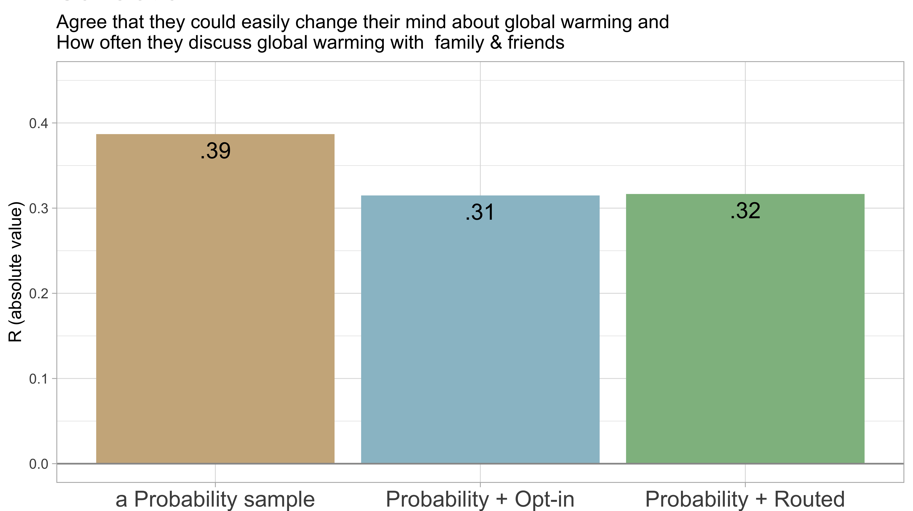

Slide 41
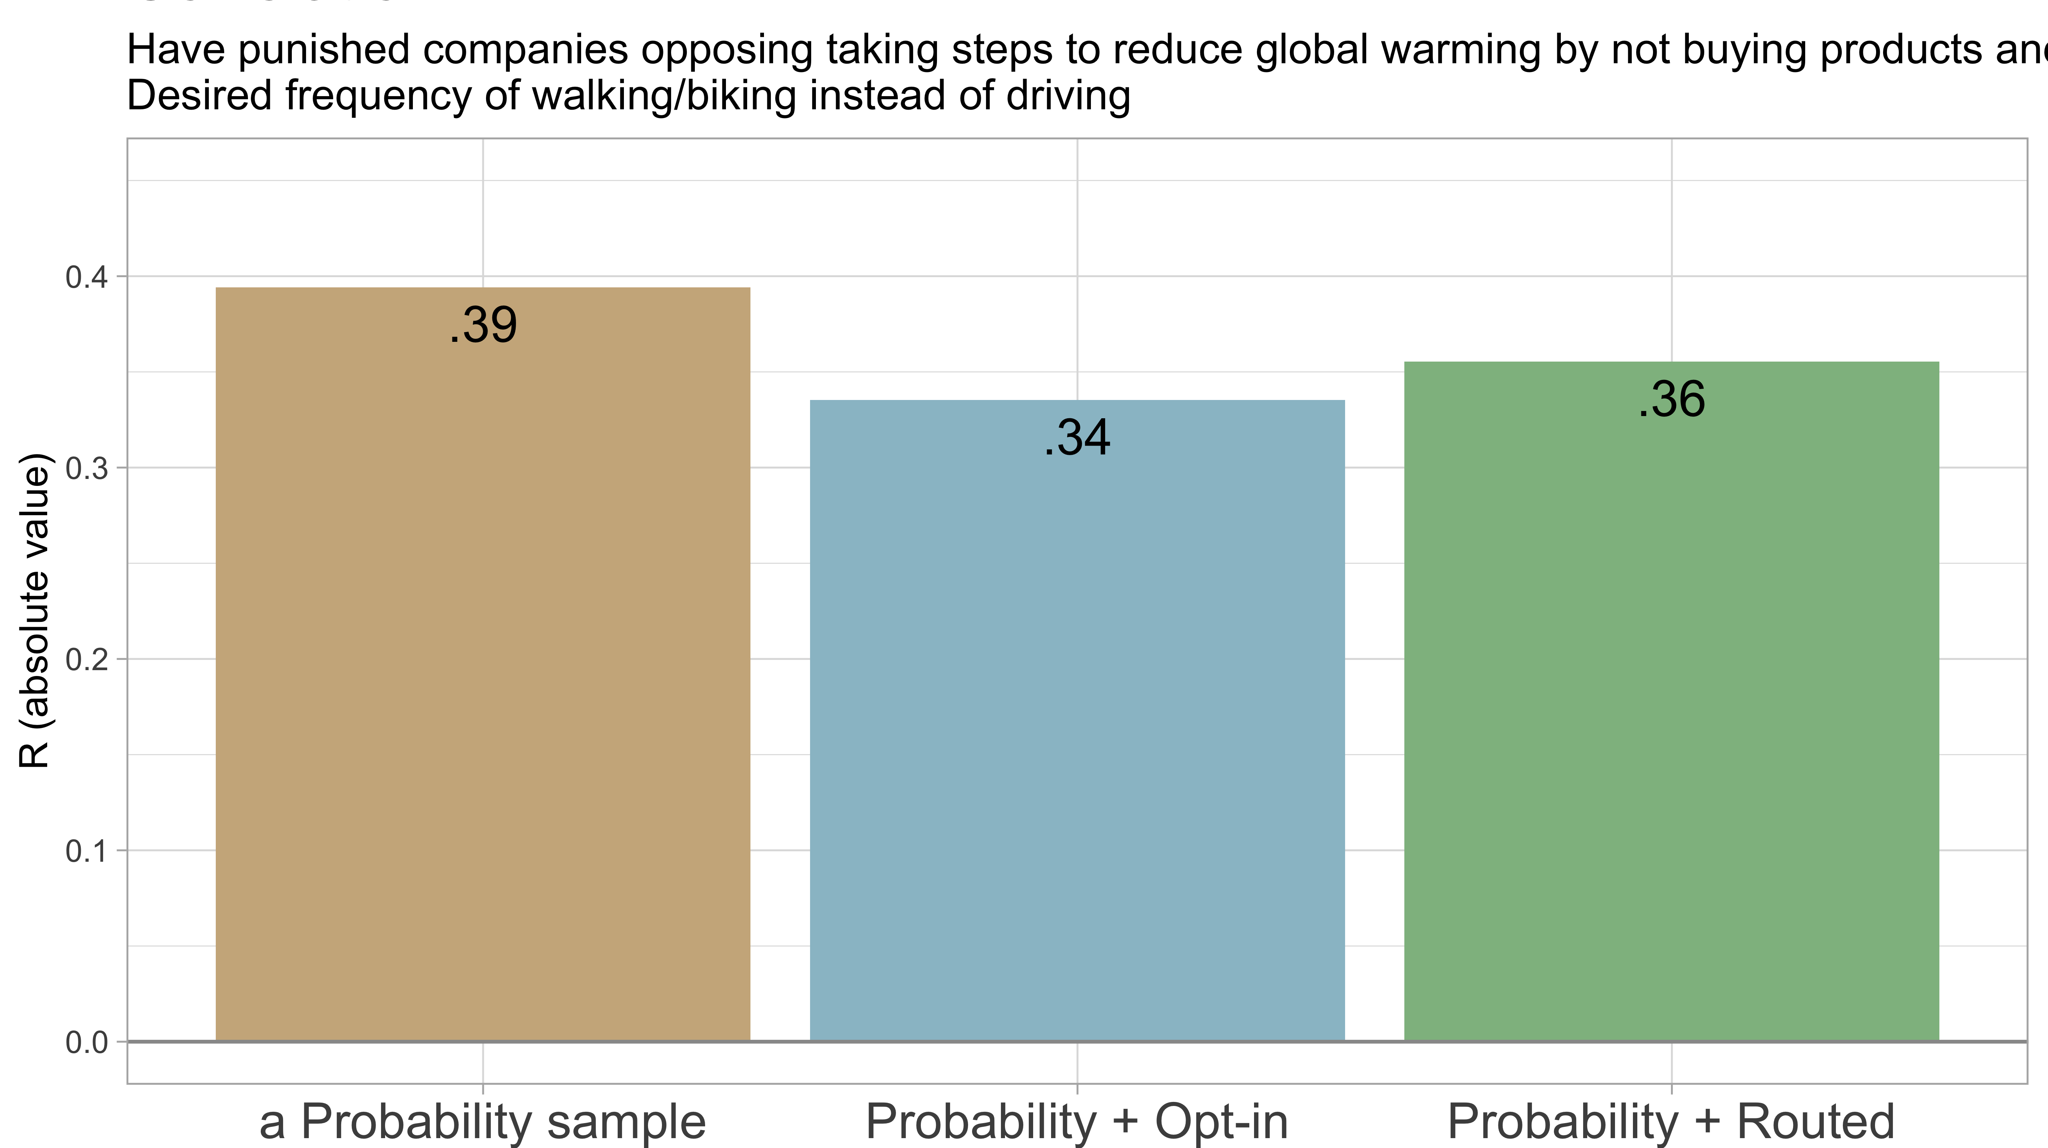

Slide 42
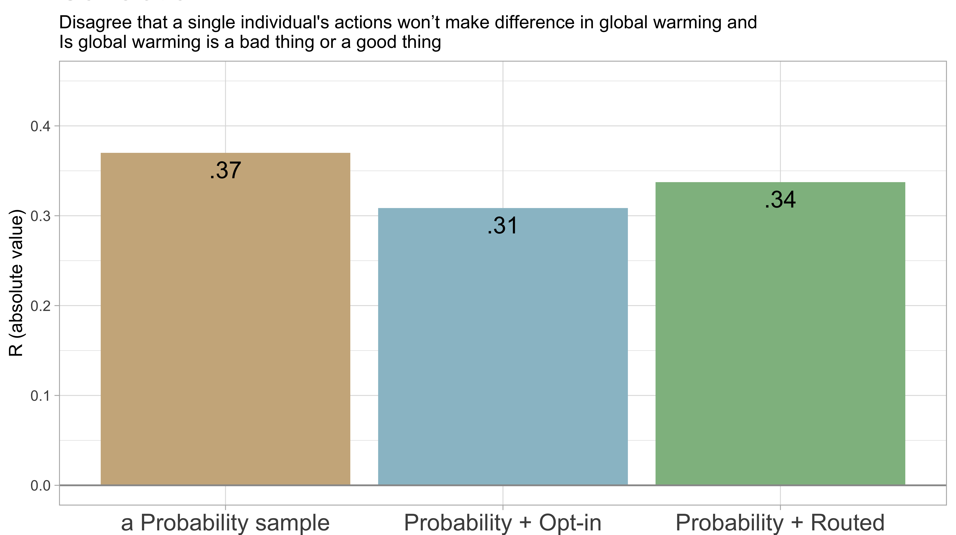

Slide 43
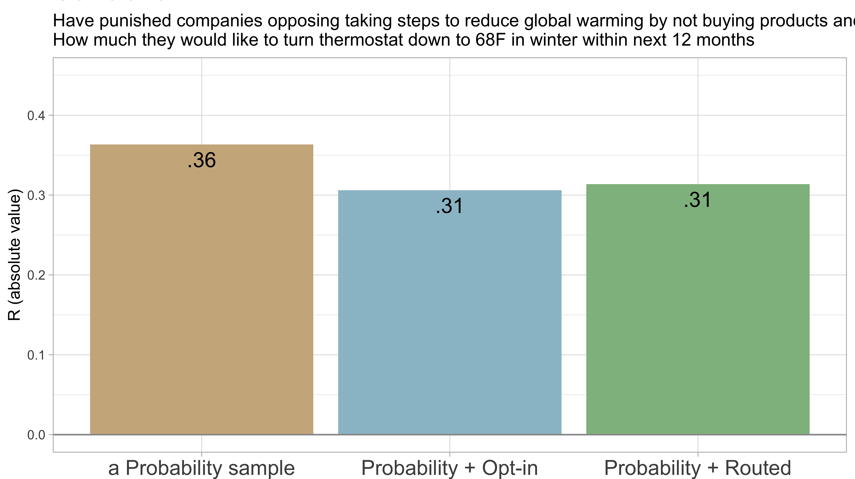

Slide 44
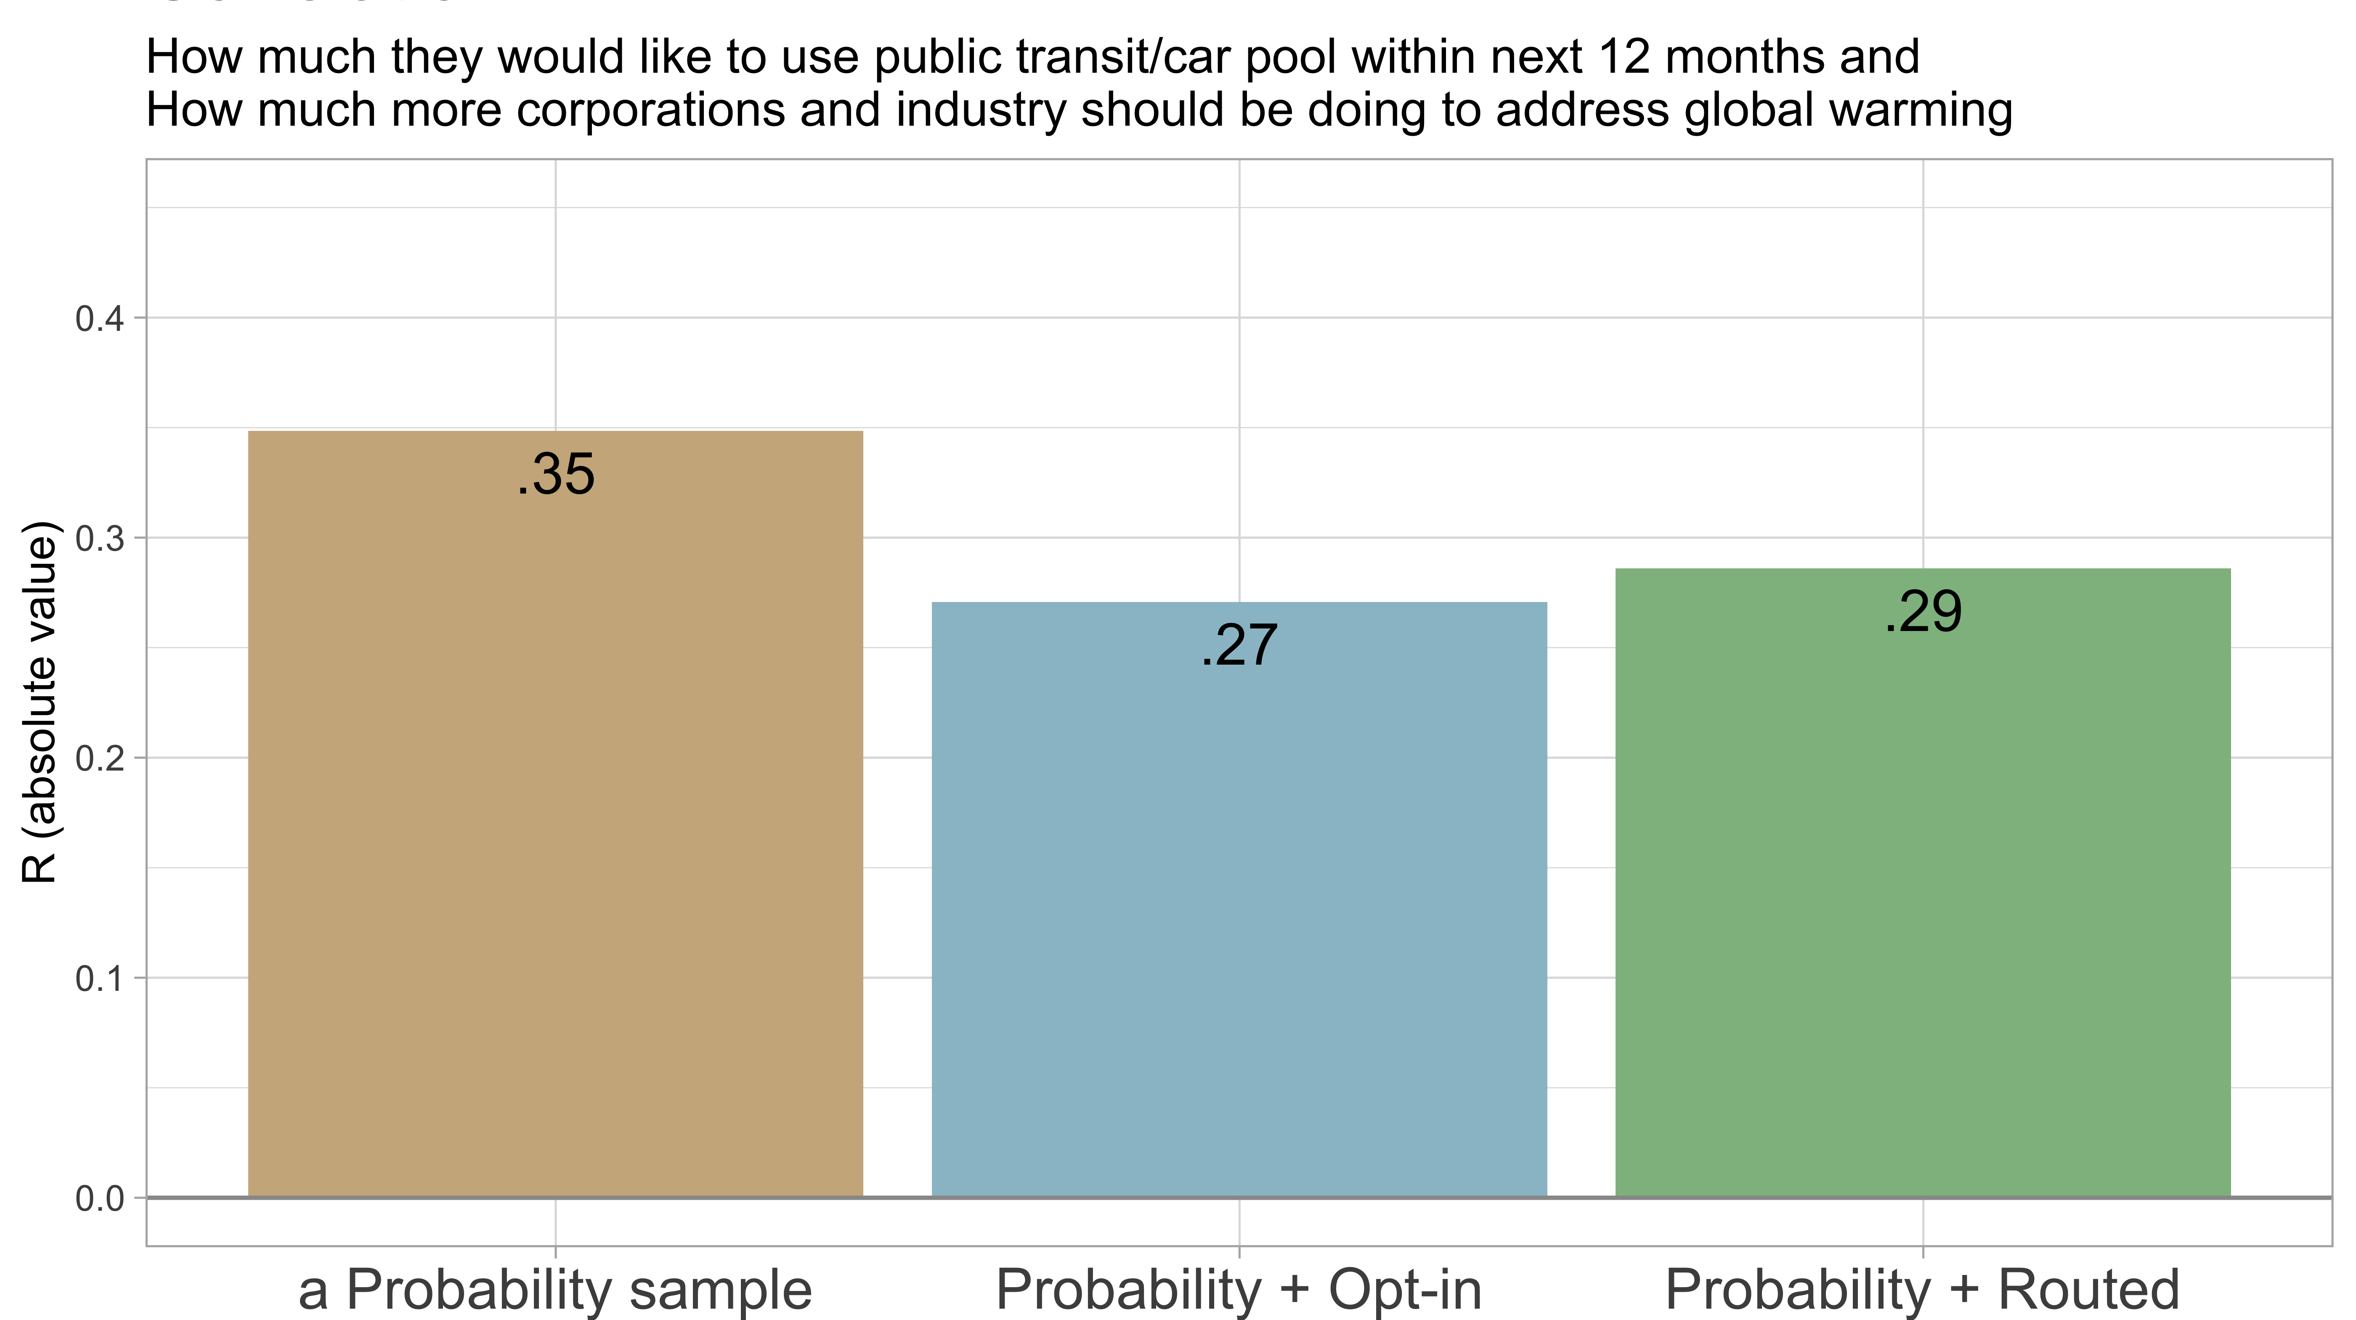

Slide 45
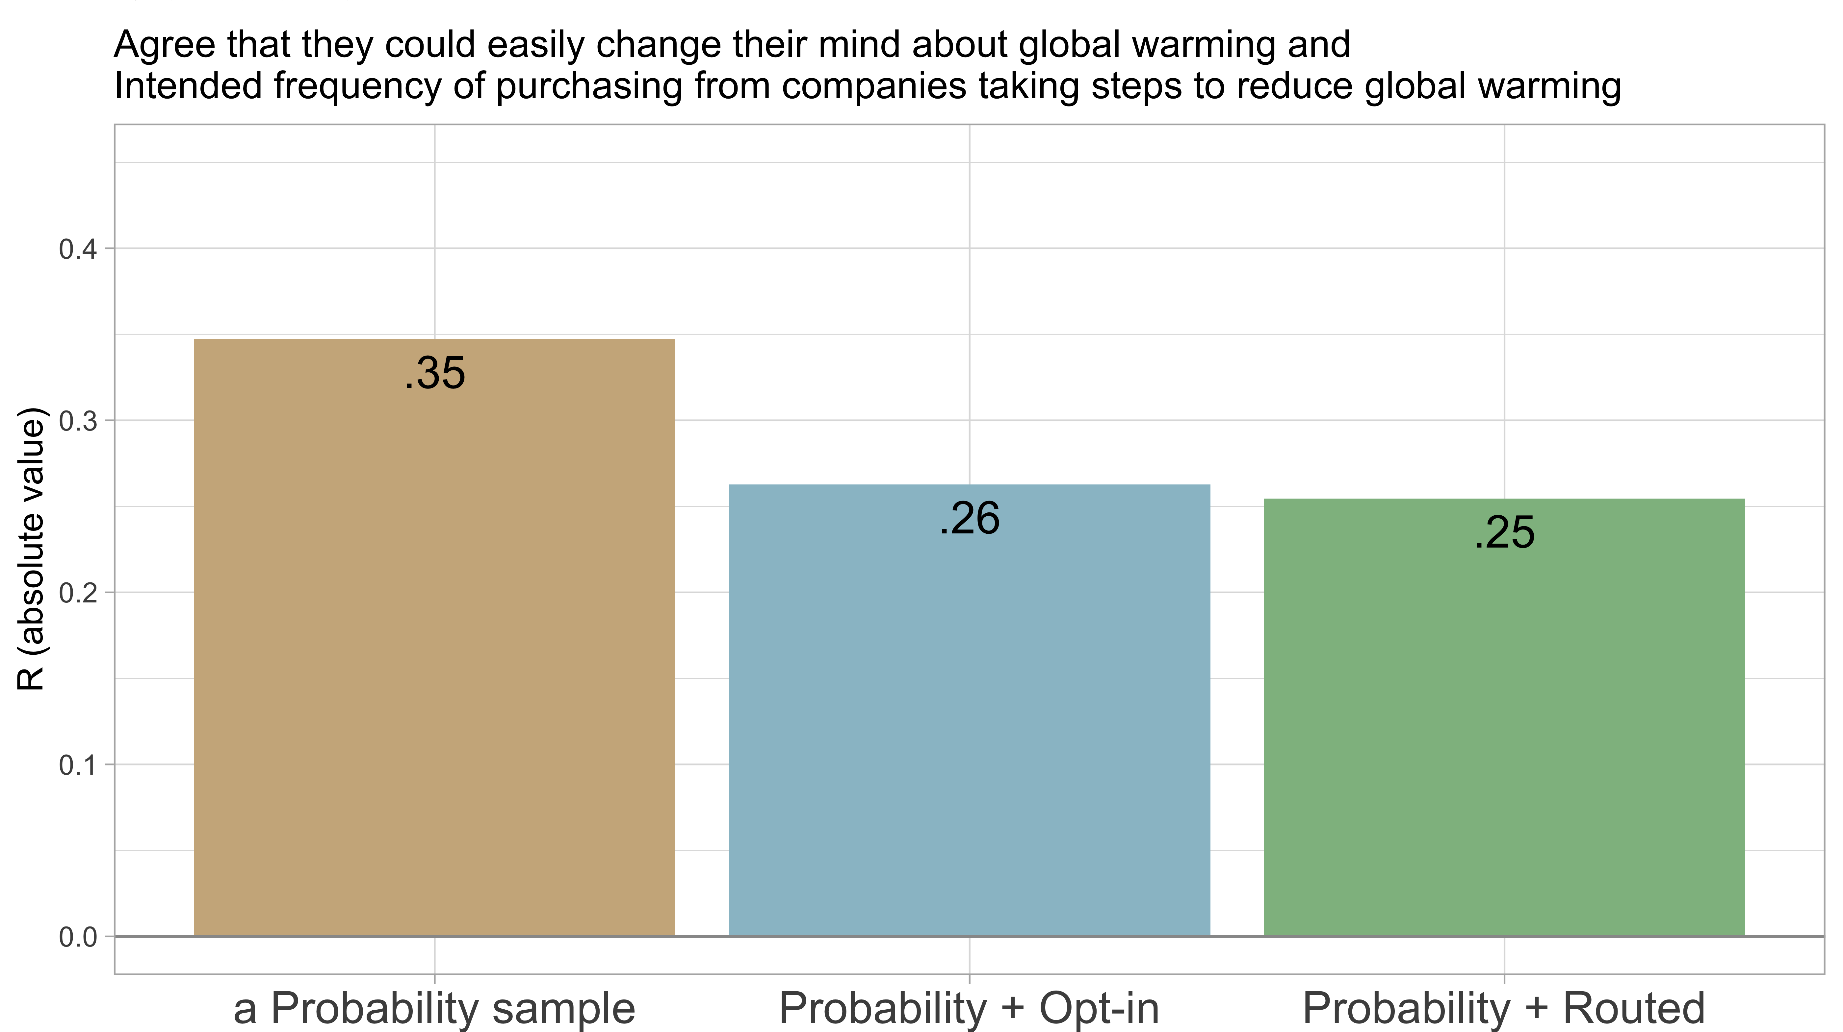

Slide 46
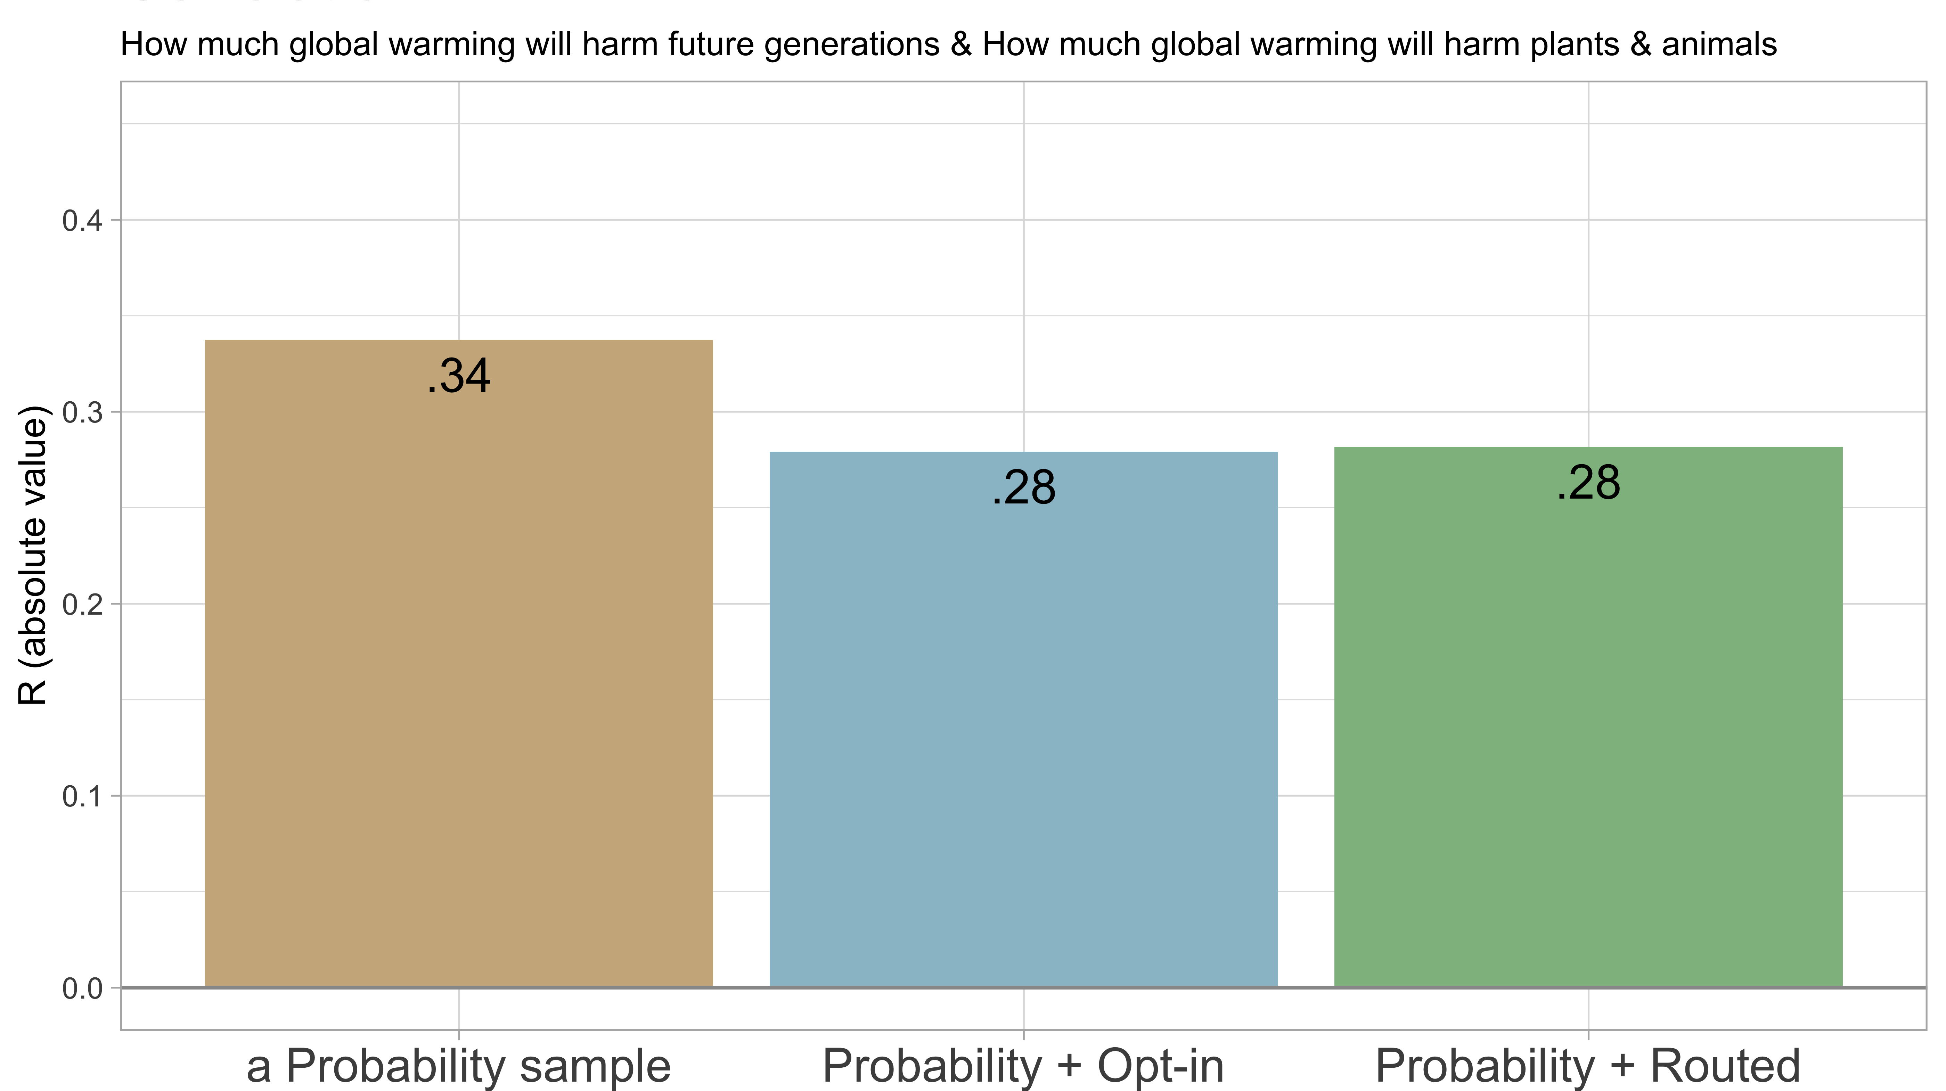

Slide 47
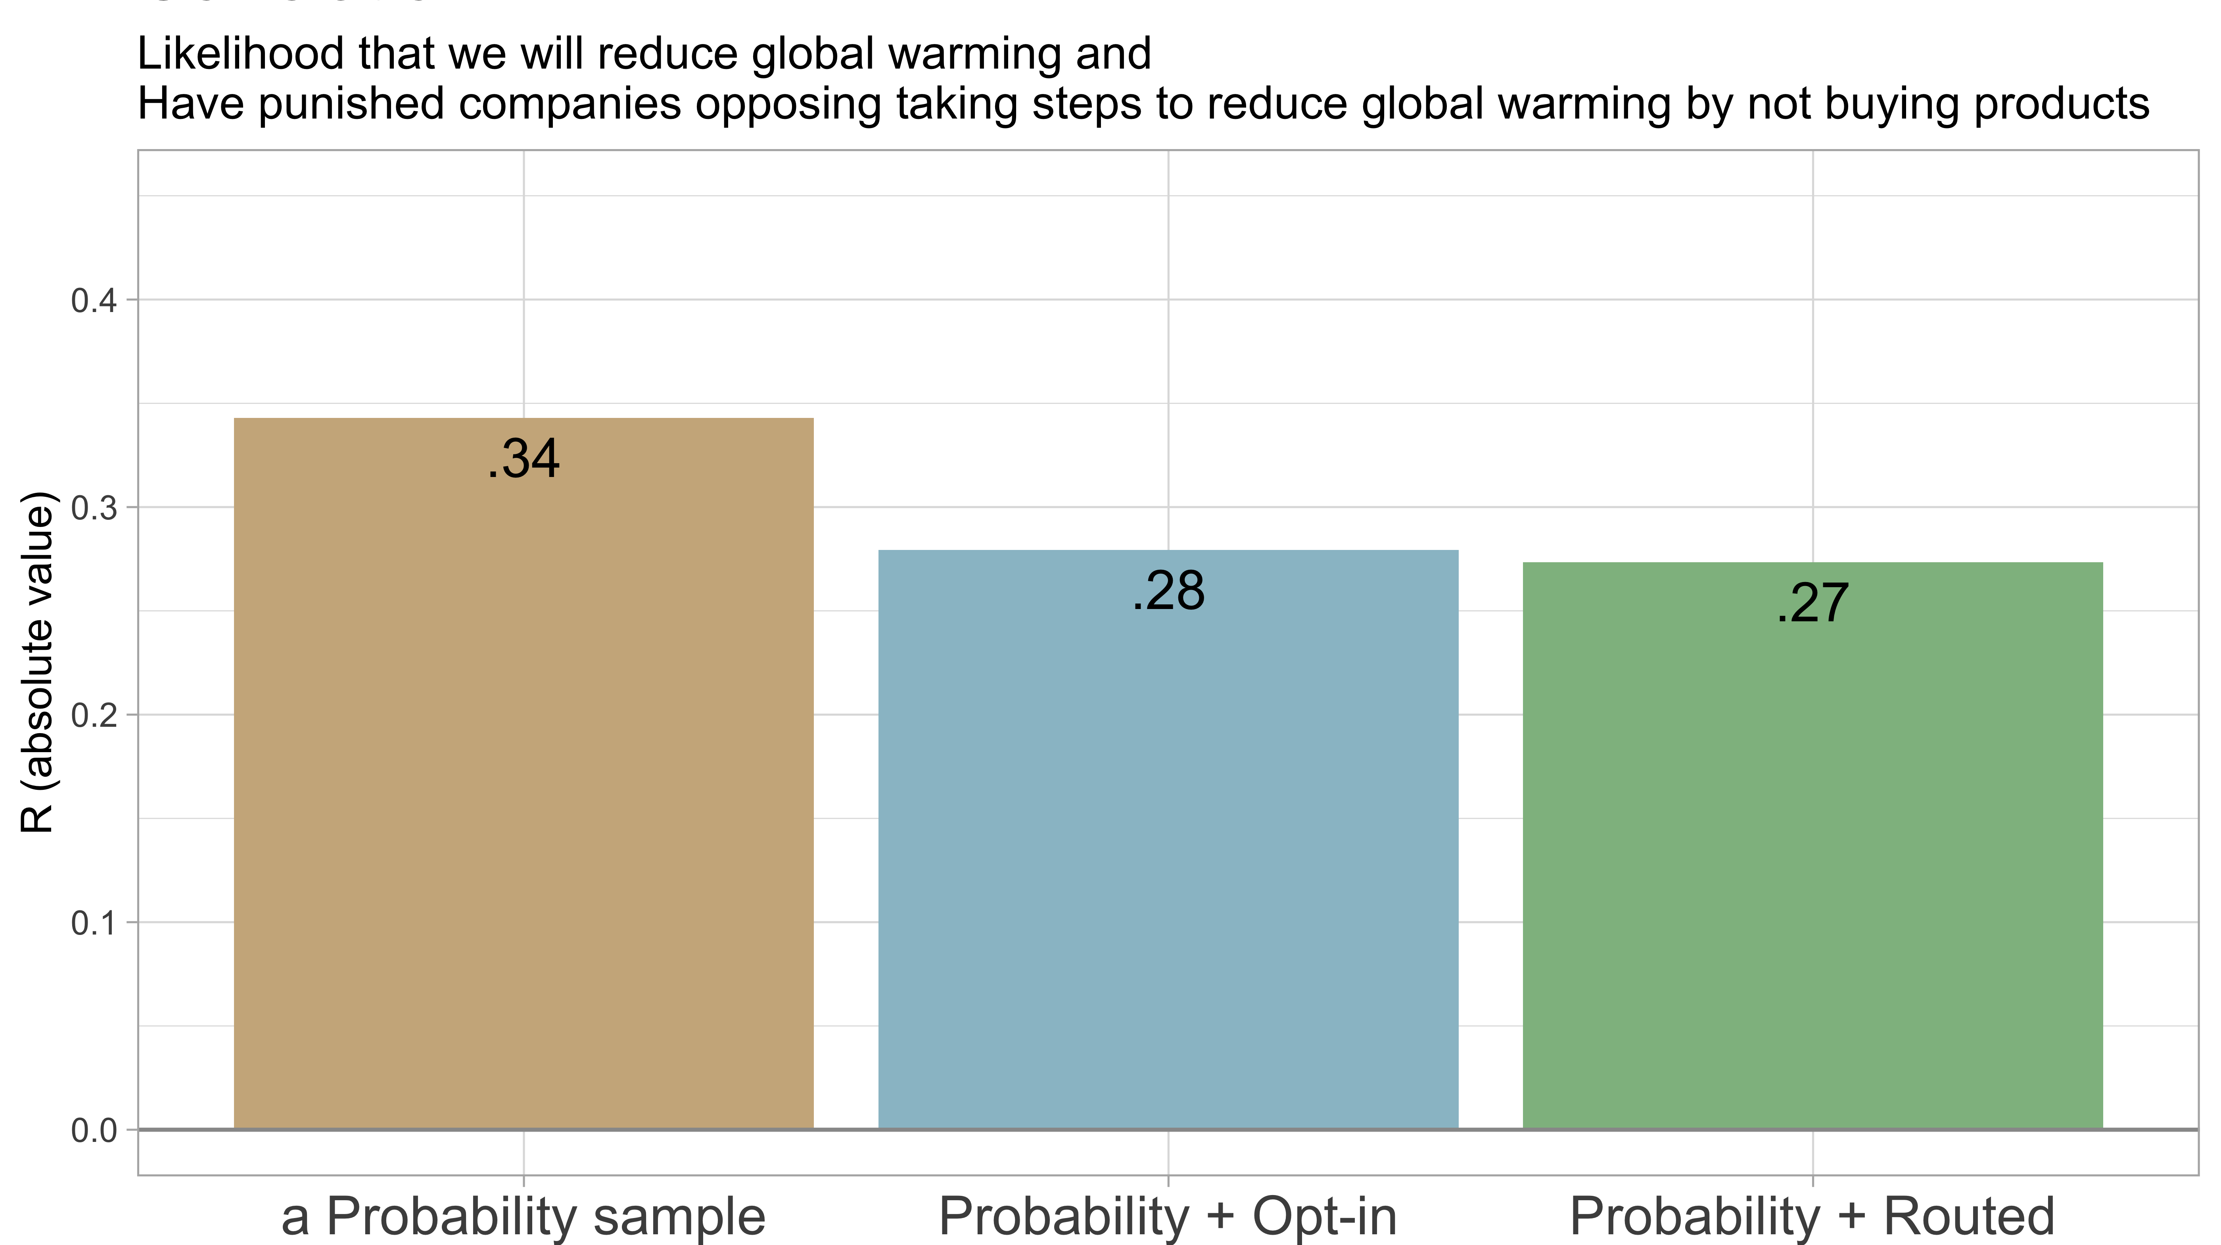

Slide 48
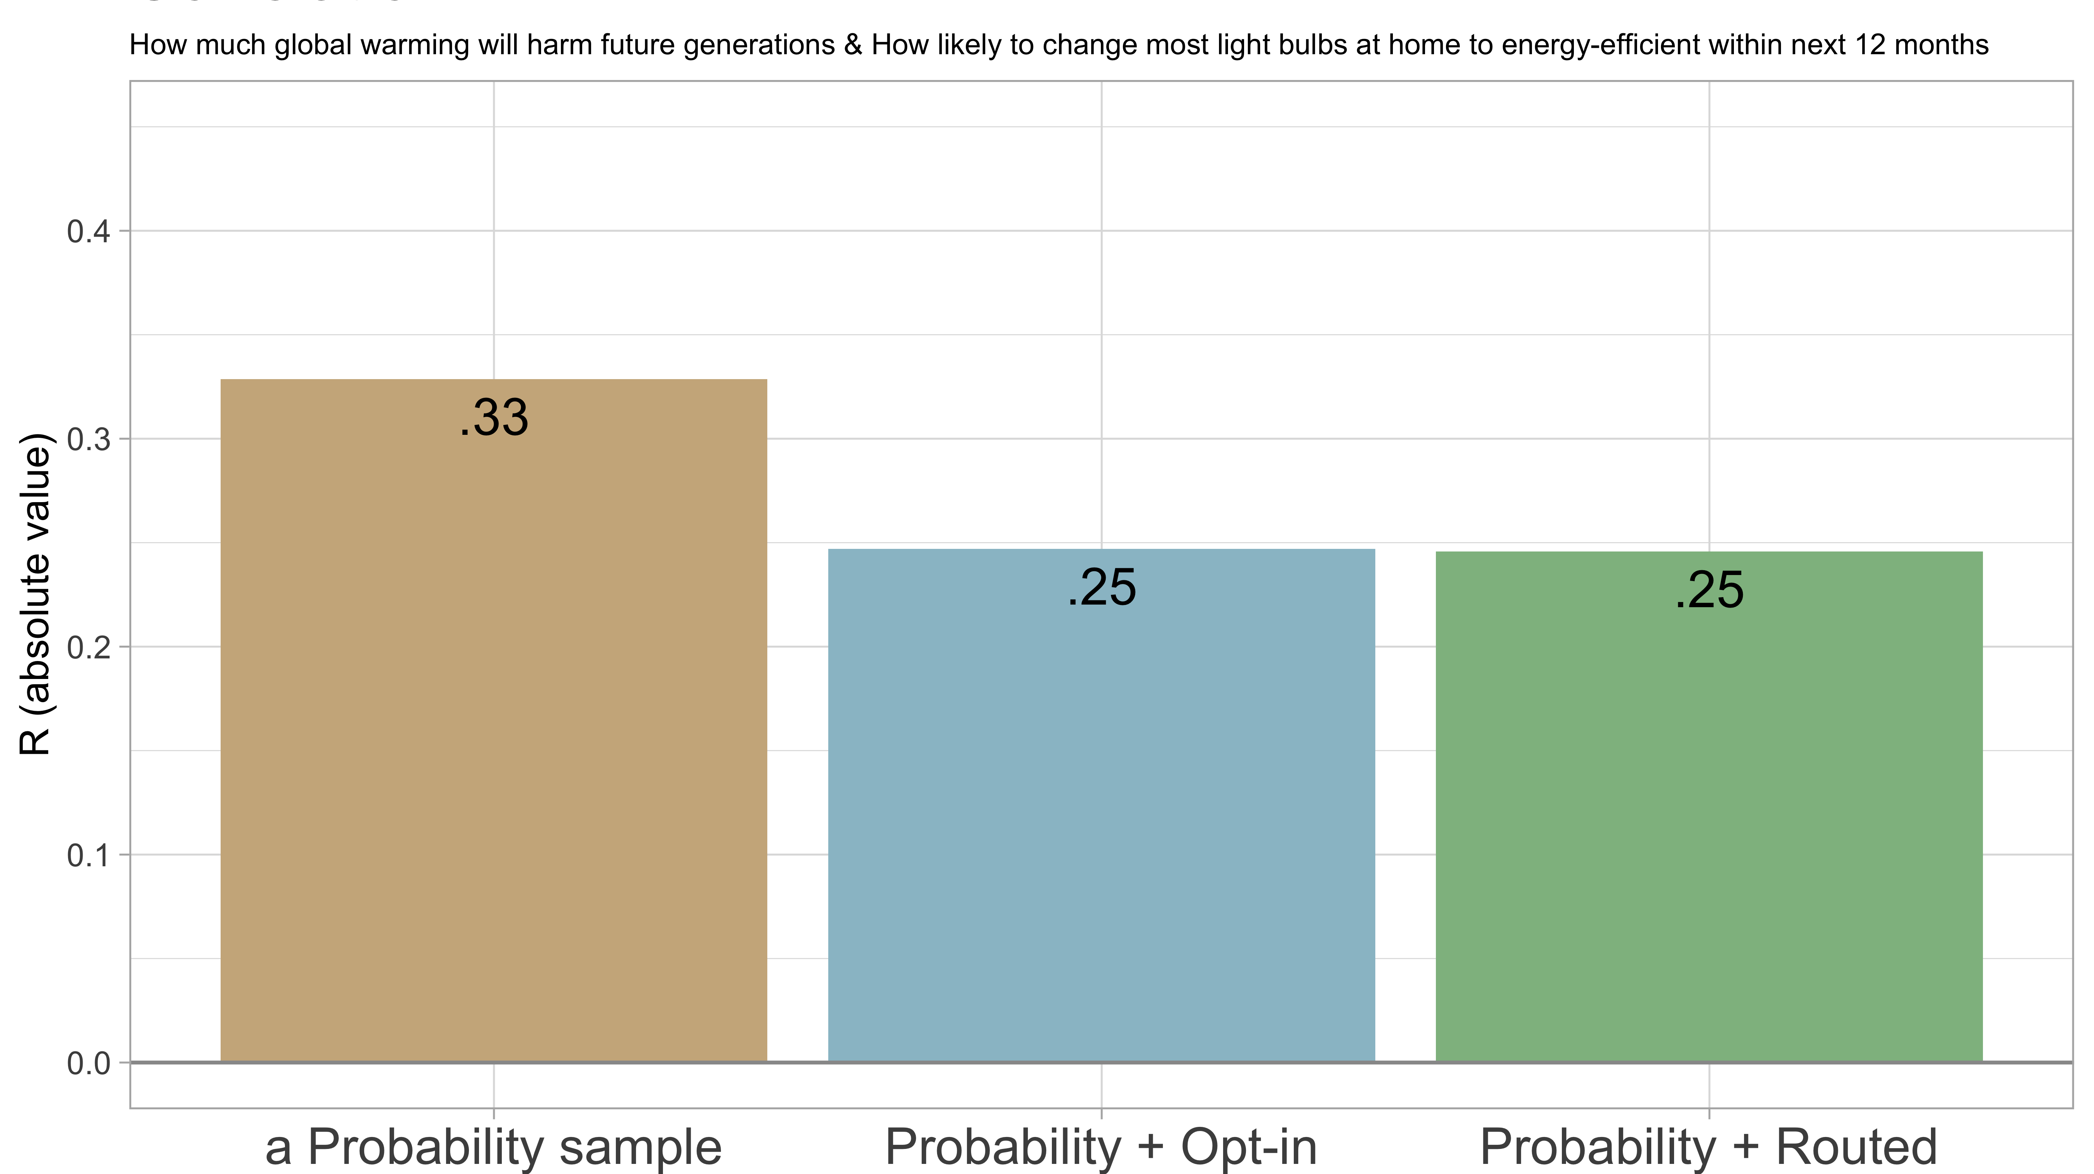

Slide 49
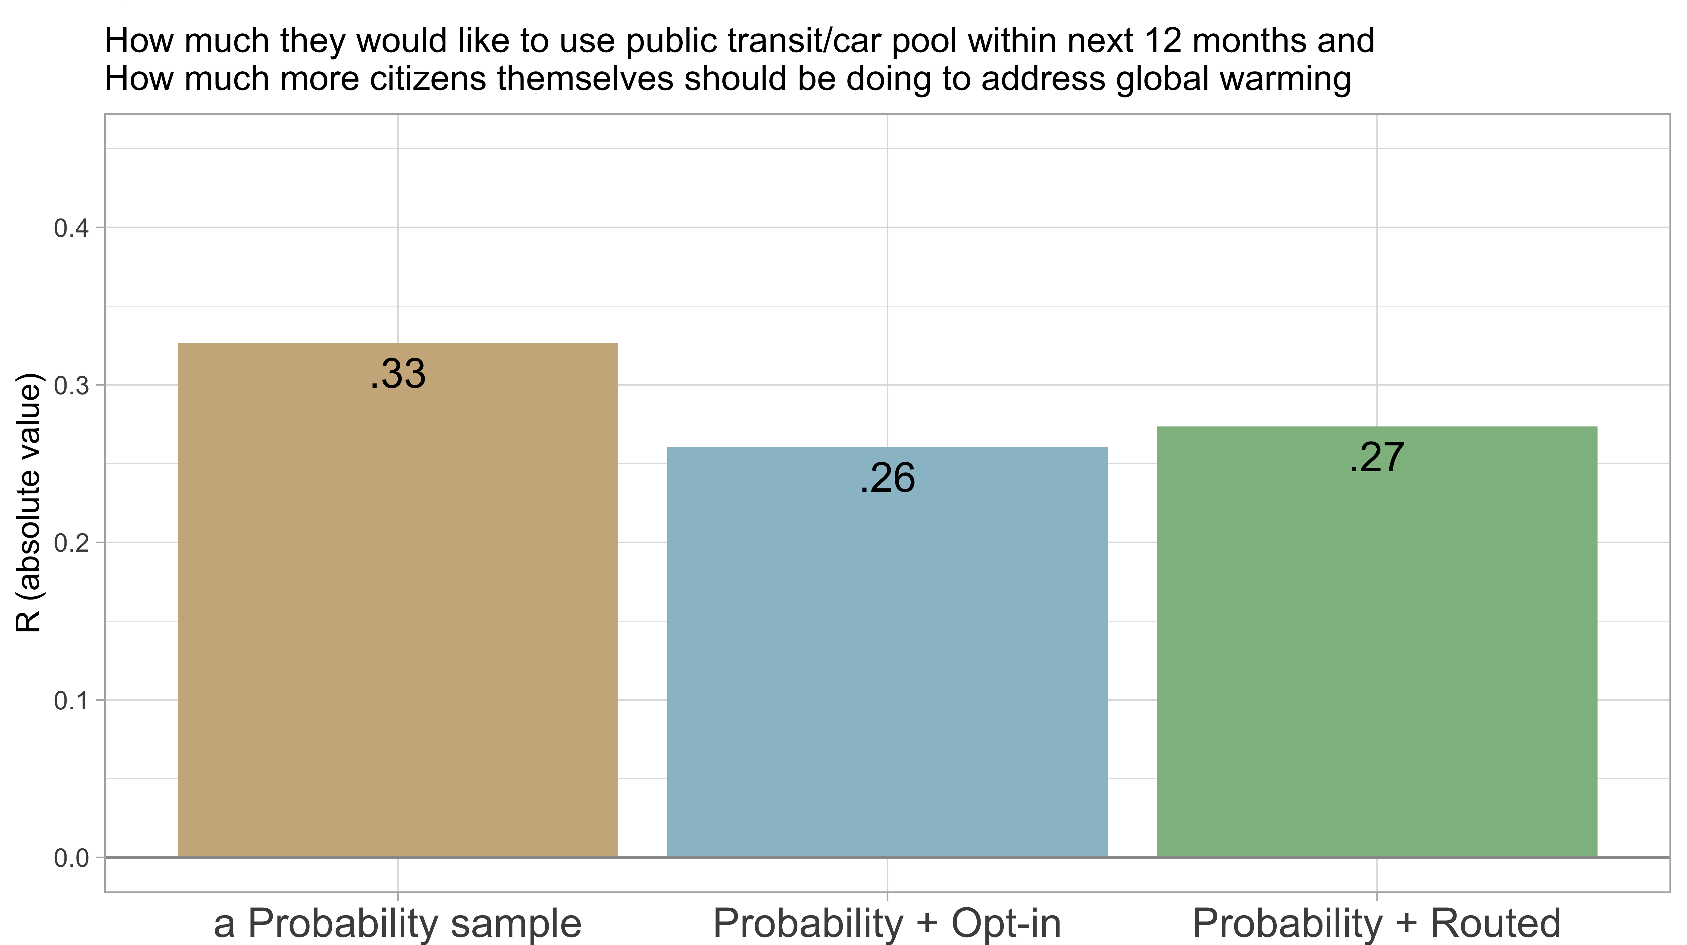

Slide 50
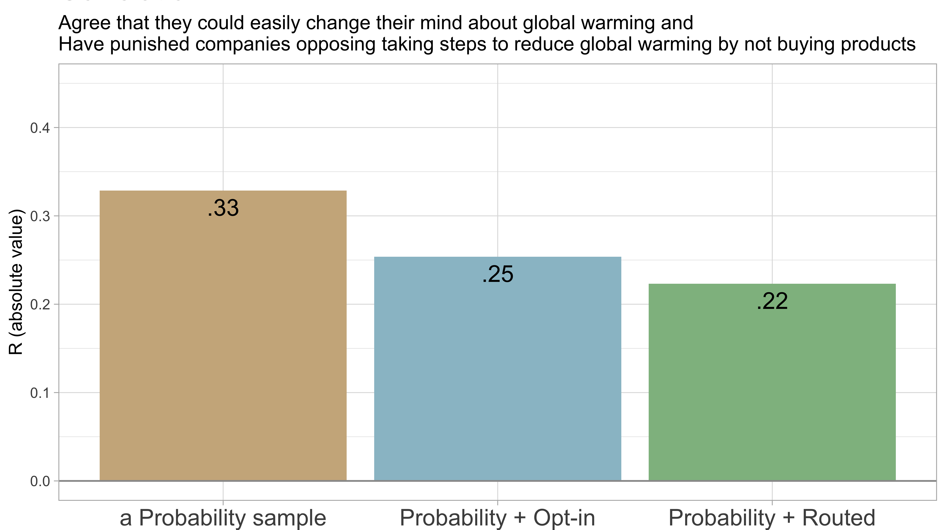

Slide 51
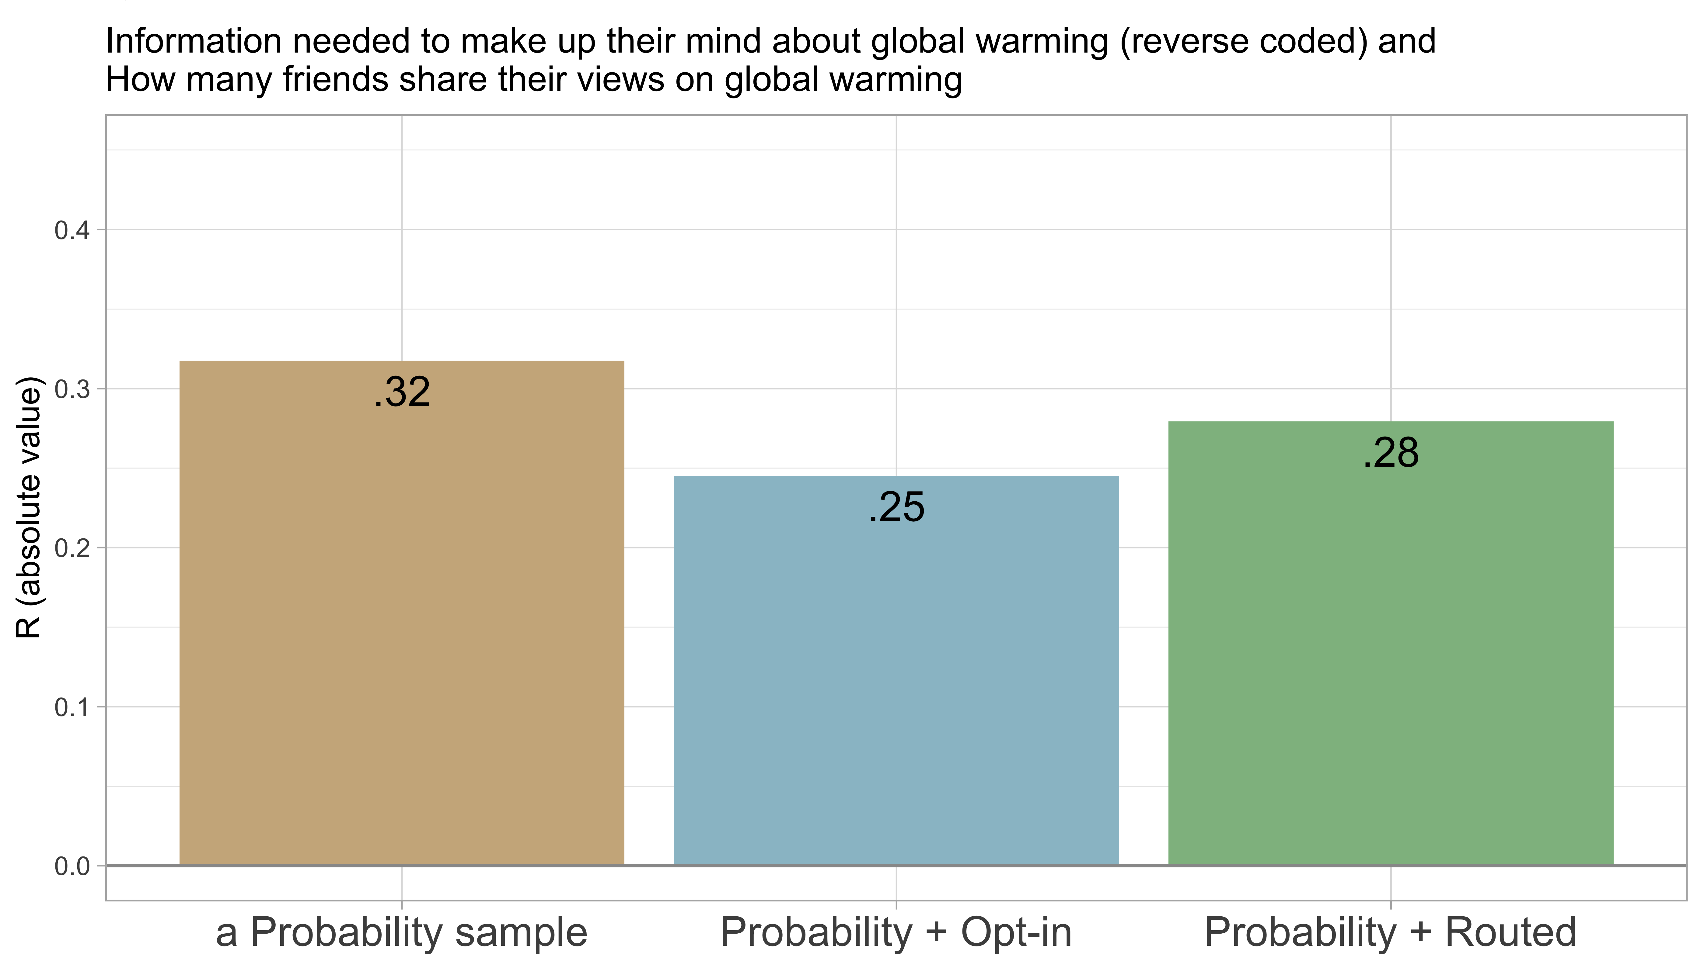

Slide 52
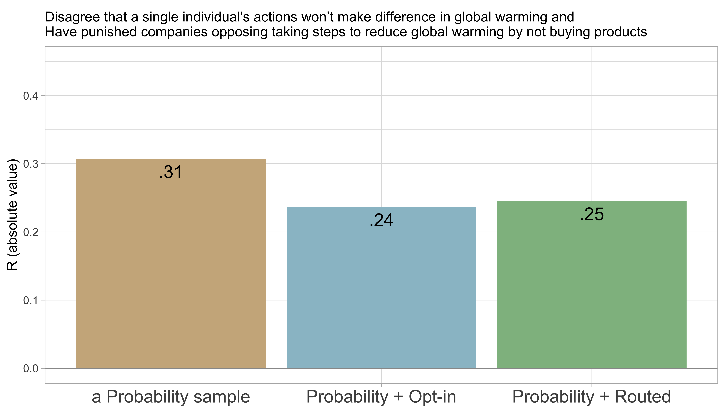

Slide 53
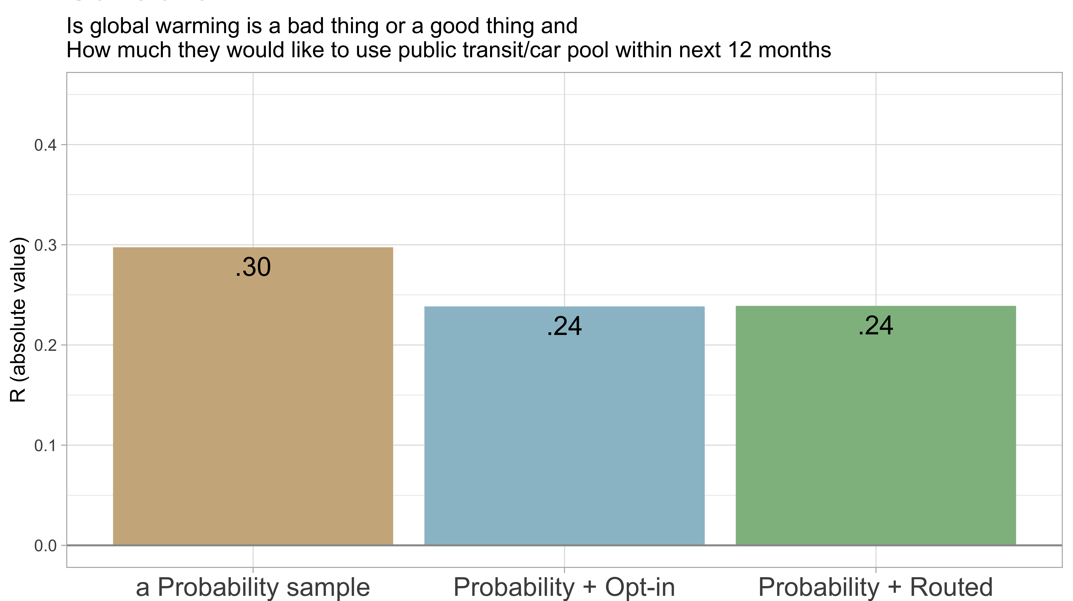

Slide 54
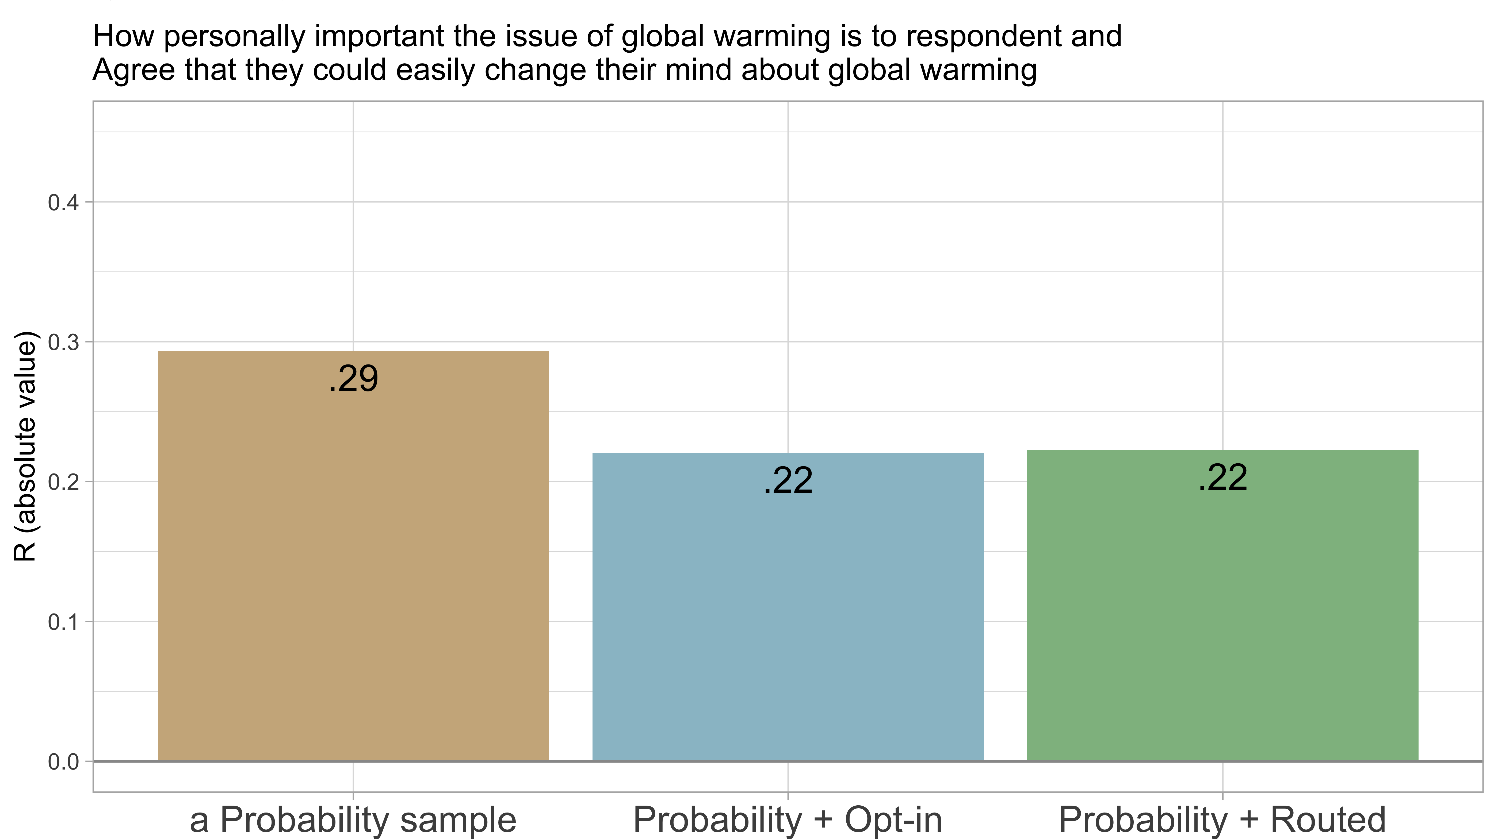

Slide 55
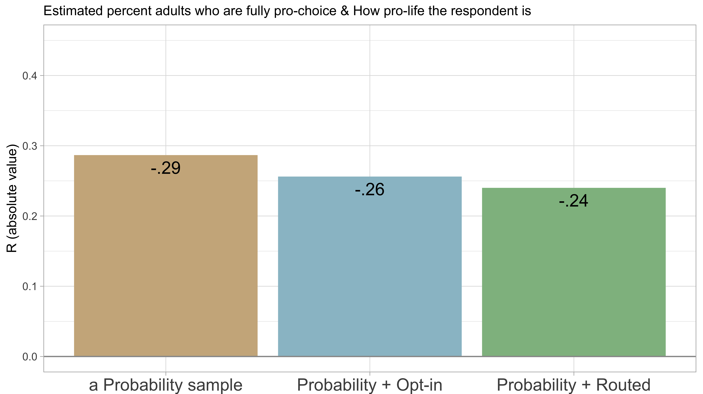

Slide 56


Slide 57


Slide 58


Slide 59


Slide 60


Slide 61


Slide 62


Slide 63


Slide 64


Slide 65


Slide 66


Slide 67


Slide 68


Slide 69


Slide 70


Slide 71


Slide 72


Slide 73


Slide 74


Slide 75


Slide 76


Slide 77


Slide 78


Slide 79


Slide 80


Slide 81


Slide 82


Slide 83


Slide 84


Slide 85


Slide 86


Slide 87


Slide 88


Slide 89


Slide 90


Slide 91


Slide 92


Slide 93


Slide 94


Slide 95


Slide 96


Slide 97


Slide 98



Slide 99


Slide 100


Slide 101


Slide 102


Slide 103


Slide 104


Slide 105


Slide 106


Slide 107


Slide 108


Slide 110


Slide 111

Correlations $(R$) between questions
$$R_{prob}≤R_{blend}$$
25

Slide 112


Slide 113


Slide 114


Slide 115


Slide 116


Slide 117


Slide 118


Slide 119


Slide 120


Slide 121


Slide 122


Slide 123


Slide 124


Slide 125


Slide 126


Slide 127


Slide 128


Slide 129


Slide 131


Slide 132


Slide 133


Slide 134


Slide 135


Slide 136


Slide 137
An Unexpected Pattern
Correlations weakened by adding blended sample:
  92% of correlations are negative (so adding blended sample makes correlations more negative)
Correlations strengthened by adding blended sample:
  88% of correlations are negative (so adding blended sample makes correlations more negative)
So blending samples makes correlations more negative
?????????

Slide 138
Distributions of variables
Correlations between variables
Results of experiments

Slide 139
Abortion Opinion Experiment

Slide 140
Treatment 1 | Pro-life arguments
Next, we would like to ask how convincing you find a series of things people have said about whether abortion should or should not be legal…
Negative psychological consequences (Post Abortion Stress Syndrome)
Negative physical consequences (increased risk of infection, blood clots, sterility, breast cancer)
Possibility of fetal pain
Murder equivalence argument
Treatment 2 | Pro-choice arguments
Next, we would like to ask how convincing you find a series of things people have said about whether abortion should or should not be legal…
Issues faced by unwanted children and their mothers
Safety and medical risks of illegal abortions
Women’s right to choose for her body
Lack of early fetal brain activity

Slide 141
Treatment 3 | U.S. is majority pro-life (i.e., not always legal)
Recent national survey of a representative sample of American adults by the Pew Research Center showed that a majority of Americans believe that abortion should be illegal under most or all circumstances. Only a minority of Americans said that abortion should be legal in all circumstances.
Treatment 4 | U.S. is majority pro-choice (i.e., not always illegal)
Recent national survey of a representative sample of American adults by the Pew Research Center showed that a majority of Americans believe that abortion should be legal under most or all circumstances. Only a minority of Americans said that abortion should be illegal in all circumstances.

Slide 142
Manipulation check
What percent of American adults do you think believe that abortion should be…
Legal in all circumstances? ______%
Legal in some circumstances & illegal in other circumstances? ______%
Illegal in all circumstances? ______%
Notes:
A) Do you believe that a pregnant woman having an abortion should be legal in all circumstances, legal in some specific circumstances and illegal in other circumstances, or should it never be legal?
1 Legal in all circumstances
2 Legal in some circumstances and illegal under other circumstances
3 Never legal

Slide 143
Notes:
Enlarged numbers with an asterix are statistically significant from 0
AH4. Please type a number between 0 percent and 100 percent to answer each question below. The total of your three answers should equal 100 percent.
AH4A. What percent of American adults do you think believe that abortion should be legal in all circumstances? ___________%

Slide 144
Policy preference and attitude strength
Do you believe that a pregnant woman having an abortion should be legal in all circumstances, legal in some specific circumstances and illegal in other circumstances, or should it never be legal?
How strong are your feelings about that - extremely strong, very strong, moderately strong, slightly strong, or not strong at all?
How important is the issue of abortion to you personally – extremely important, very importantly, moderately important, slightly important, or not at all important?
Notes:
A) Do you believe that a pregnant woman having an abortion should be legal in all circumstances, legal in some specific circumstances and illegal in other circumstances, or should it never be legal?
1 Legal in all circumstances
2 Legal in some circumstances and illegal under other circumstances
3 Never legal

Slide 145
Policy preferences and attitude strength
Do you believe that a pregnant woman having an abortion should be legal in all circumstances, legal in some specific circumstances and illegal in other circumstances, or should it never be legal?
NO SIGNIFICANT TREATMENT EFFECTS
How strong are your feelings about that - extremely strong, very strong, moderately strong, slightly strong, or not strong at all?
NO SIGNIFICANT TREATMENT EFFECTS
How important is the issue of abortion to you personally – extremely important, very importantly, moderately important, slightly important, or not at all important?
Notes:
A) Do you believe that a pregnant woman having an abortion should be legal in all circumstances, legal in some specific circumstances and illegal in other circumstances, or should it never be legal?
1 Legal in all circumstances
2 Legal in some circumstances and illegal under other circumstances
3 Never legal

Slide 146
Notes:
Enlarged numbers with an asterix are statistically significant from 0
Note: with p val = 0.105, the diff between treatment effects for Treatment 1 is close to being stat sig @ 90% conf level for Probability + opt-in sample vs. Probability + routed sample
AH3. How important is the issue of abortion to you personally – extremely important, very importantly, moderately important, slightly important, or not at all important?
1 Extremely important
2 Very important
3 Moderately important
4 Slightly important
5 Not at all important

Slide 147
Conclusions
Probability samples are most accurate
Blended samples are less accurate than probability samples
Blended samples are more accurate than non-probability samples alone
Distributions of opinions differ by as much as 4 percentage points
Correlations between variables are usually stronger (and more positive) for probability samples than blended samples
Blended samples sometimes fail to detect experimental treatment effects documented by probability samples.

